Slide 1
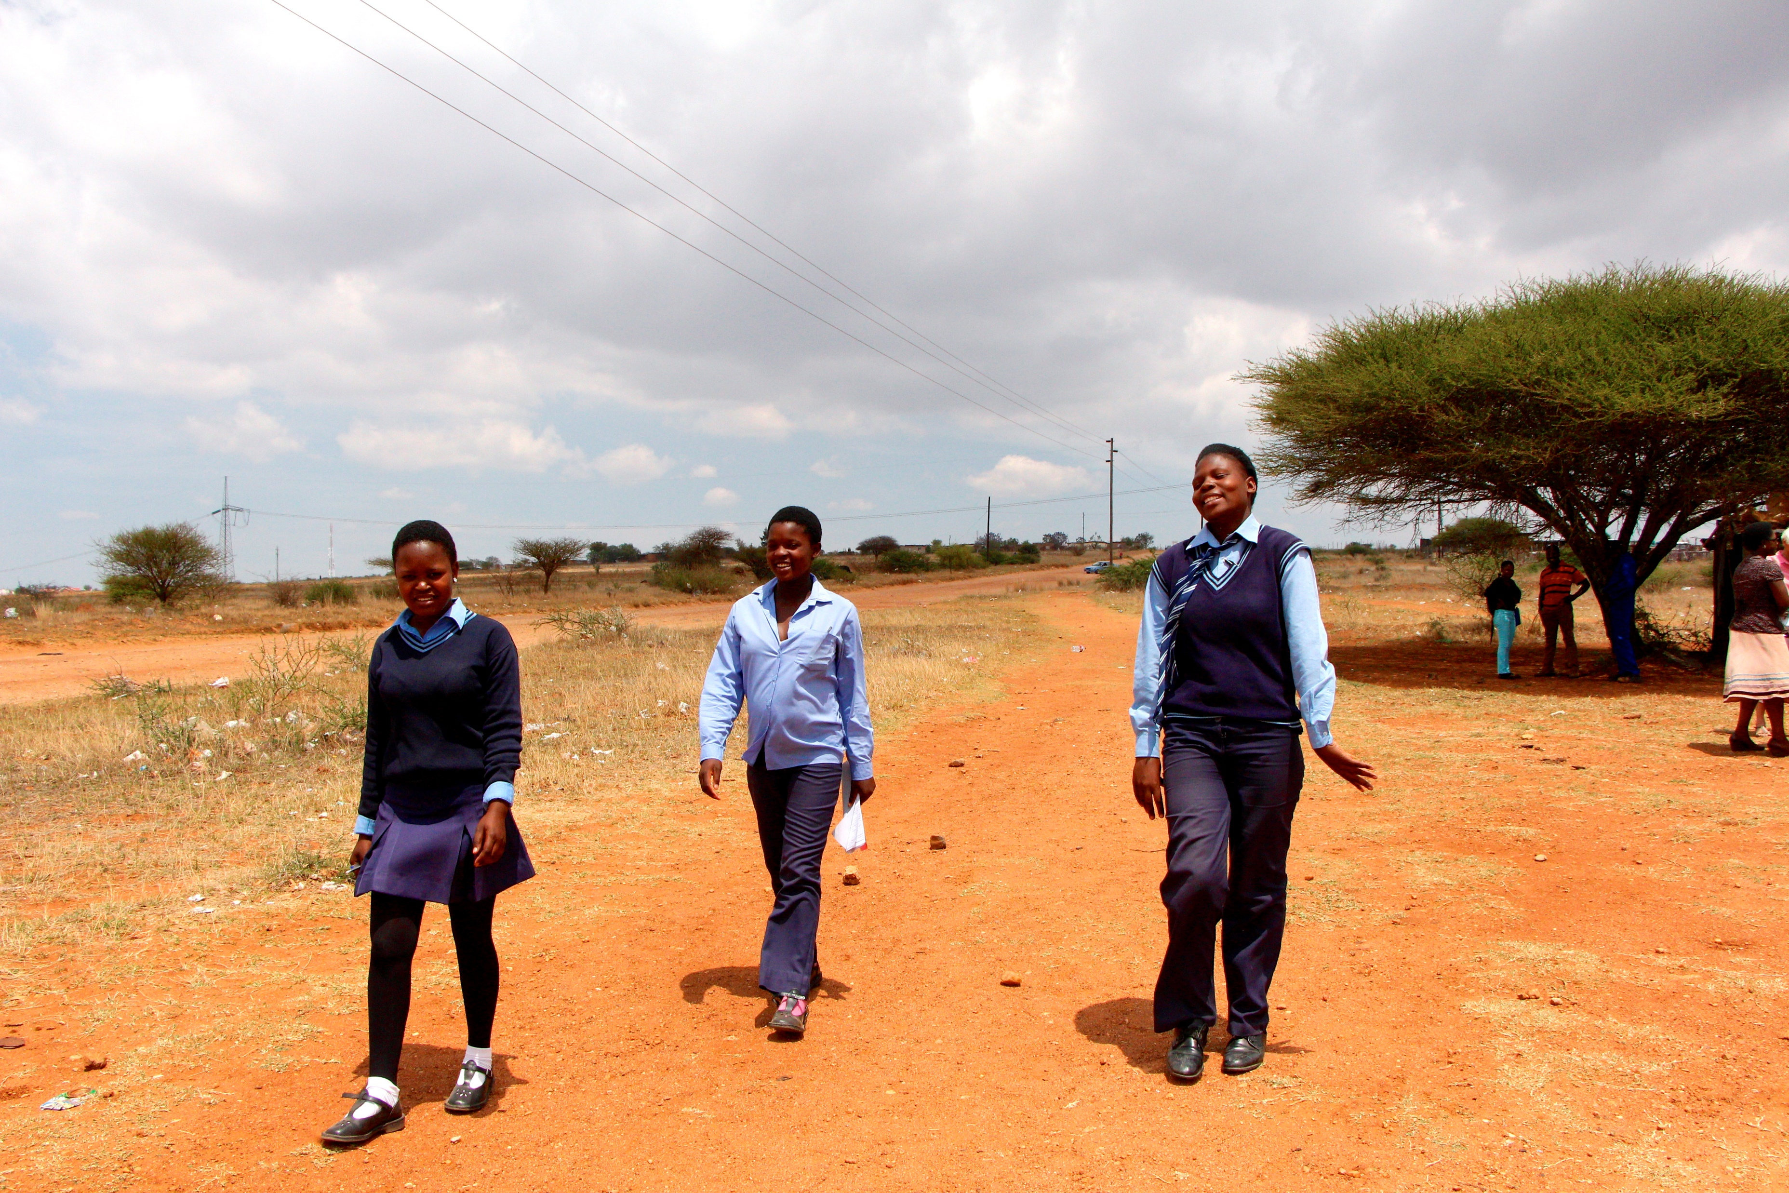
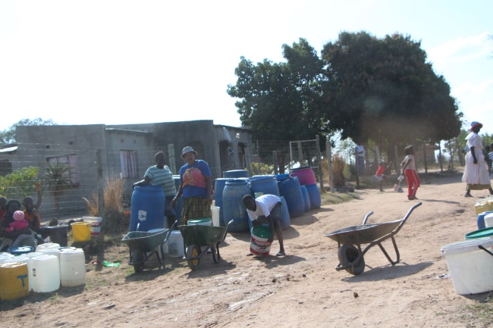
Rural South African youth migration, livelihood prospects and Covid impacts
Mark Collinson PhD
MRC/ Wits Agincourt Unit
School of Public Health, Wits University
South African National Population Research Infrastructure Network (SAPRIN)
World Population Day- 13 October 2021

Slide 2
Overview
SA youth bulge what are the population dynamics?
Census 2011
SAPRIN 2000-2018 (animation)
High levels of temporary migration among youth
Types of migration – age and sex profiles and trends (SAPRIN)
Youth migration and employment (Agincourt HDSS)
Impact of COVID-19 epidemic and lockdown measures
Migrant Health Follow-up Study (MHFUS)

Slide 3
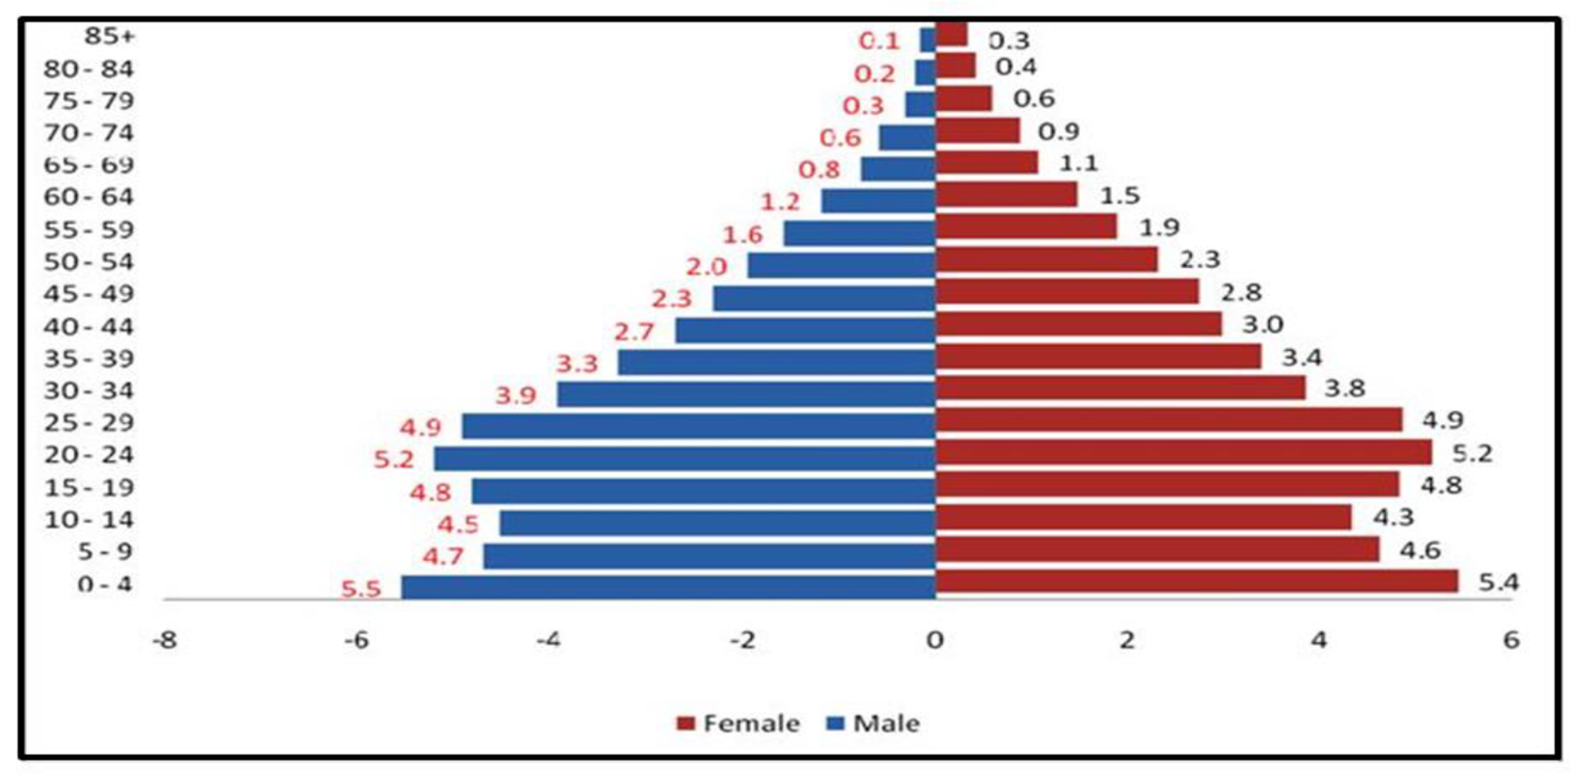
South Africa national population – Census 2011

Slide 4
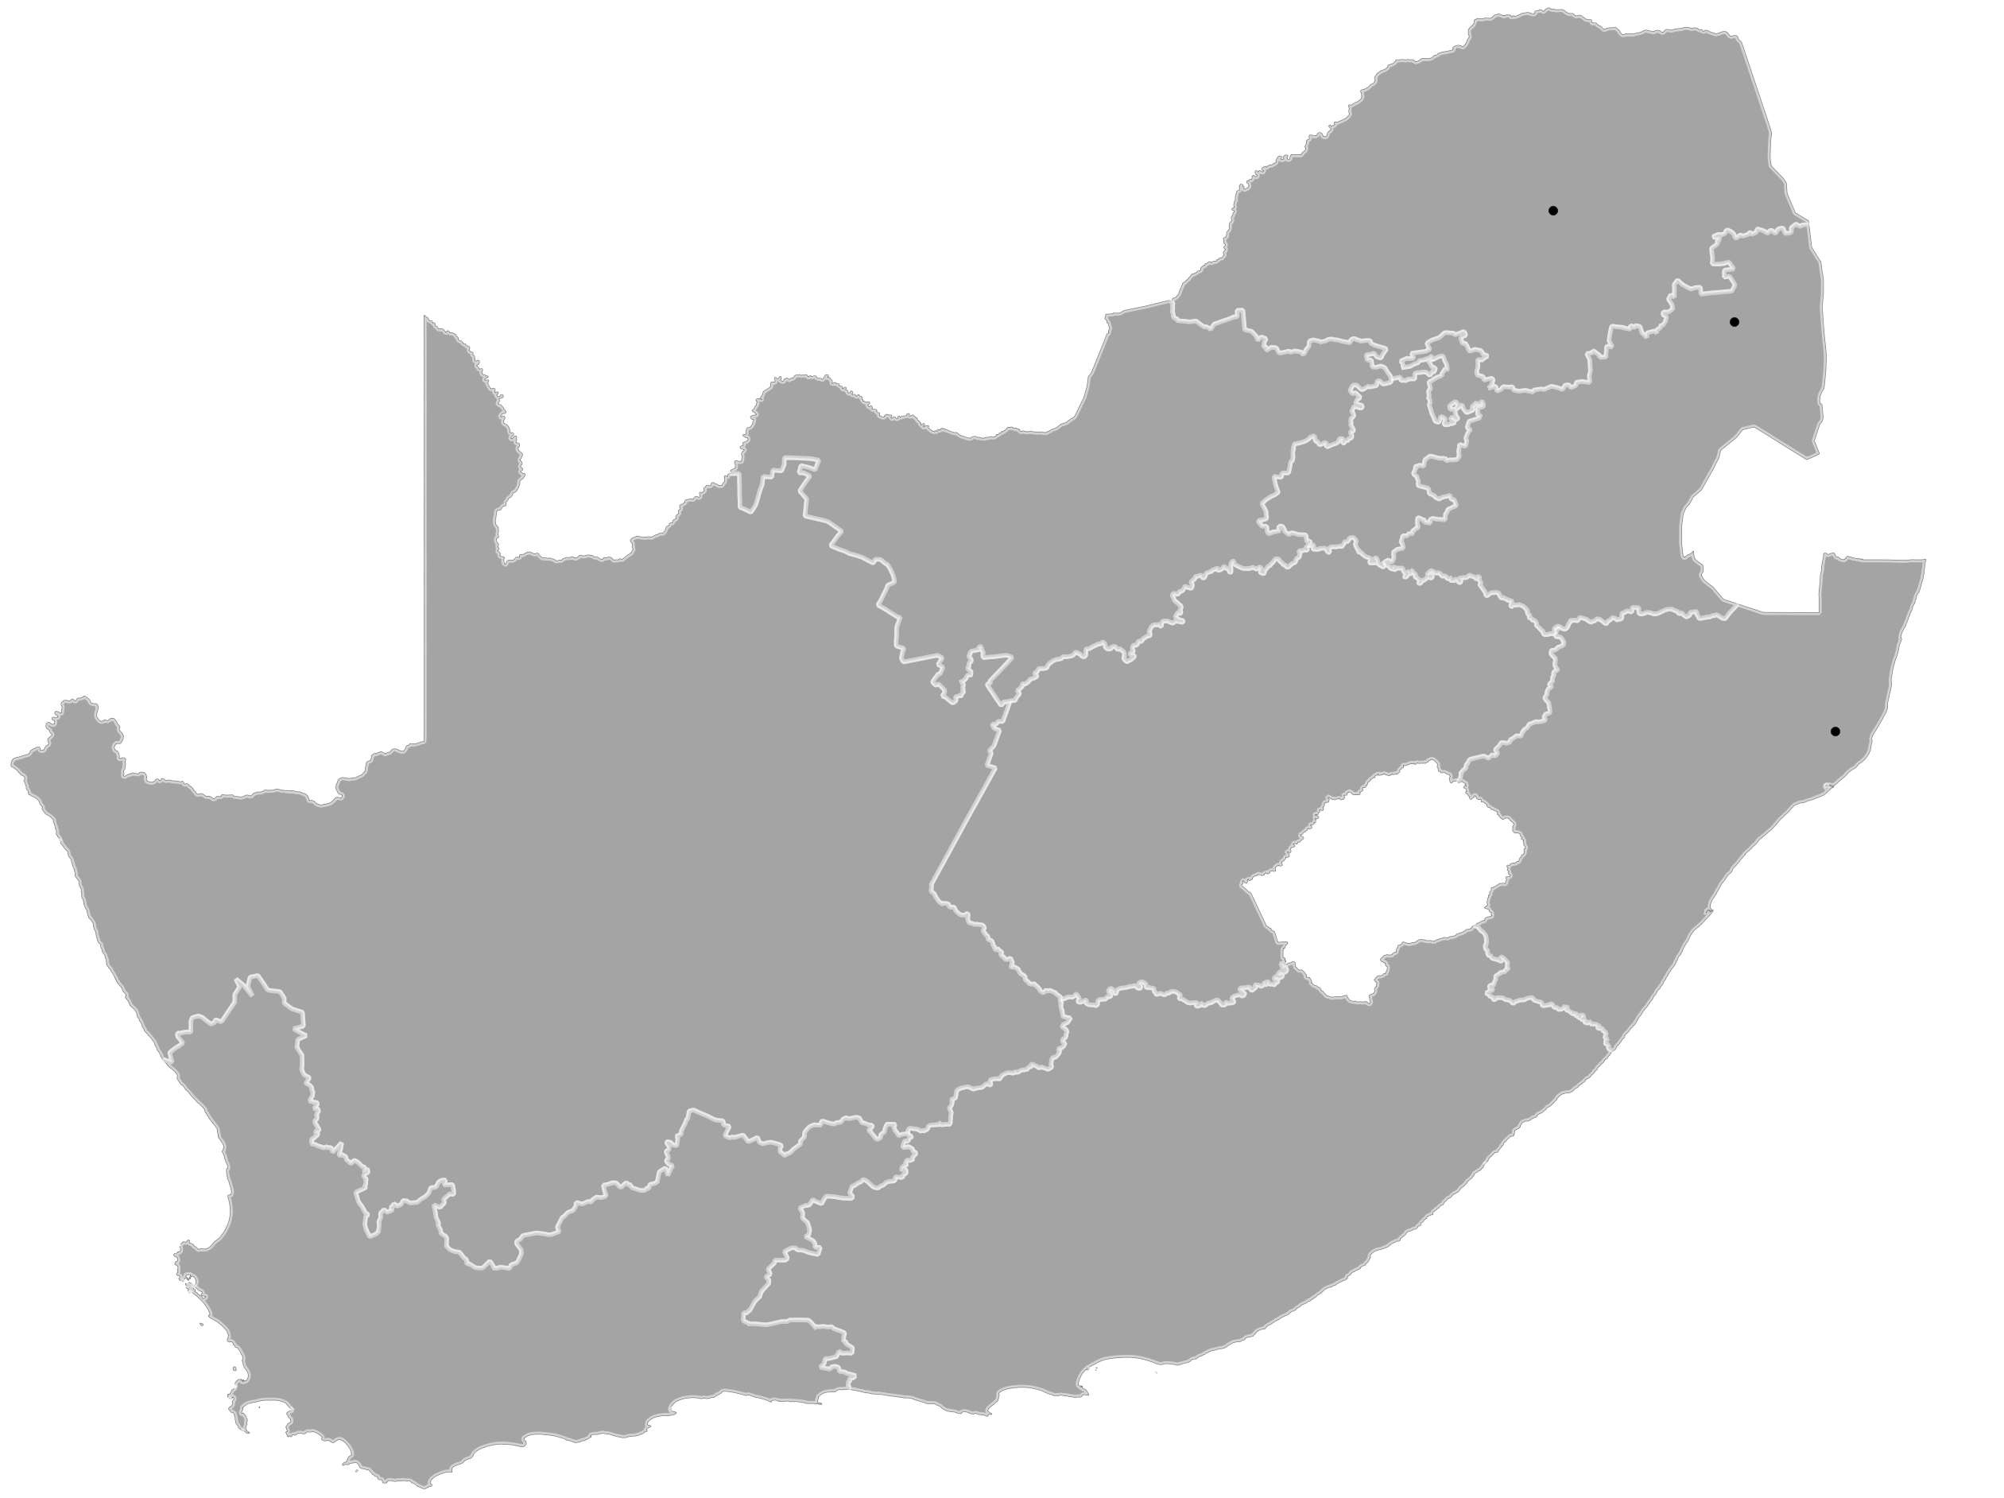
South African National Population Research Infrastructure Network (SAPRIN)
A network of population nodes (cohorts)
existing and new nodes
Impoverished communities, both rural and urban
Nodal populations of ~100 000 individuals
New nodes incorporate bi-directional, migration flows, linking poor rural communities with urban centres
DIMAMO
Peri-urban
Agincourt
Rural
Gauteng
Urban
Africa Health RI
Rural
eThekwini
Urban
Eastern Cape
Rural
Cape Town
Urban
Existing Nodes
In Development
To be Developed

Slide 5
Age sex population dynamics – SAPRIN nodes

Slide 6
Residence and non-residence, 2011

Slide 7
Age-sex profile of temporary out-migration - SAPRIN
AHRI, KZN
All nodes
combined
N=300,000
Agincourt,
Mpumalanga
DIMAMO, Limpopo

Slide 8
Age sex profile – different migration types (SAPRIN)
N=300 000
Definitive
out-migration
Definitive
in-migration
Temporary
out-migration
Temporary
In-migration

Slide 9
Percent employed – non-migrants vs temporary migrants (Agincourt)
Non-migrants,
Males
Non-migrants,
Females
Migrants,
Males
Migrants,
Males

Slide 10
Migration and Remittance – Agincourt - 2002, 2007, 2012, 2017
 |  | 2002 | 2007 | 2012 | 2017
Full population | M | 33,372 | 38,085 | 43,843 | 58,582
 | F | 35,897 | 41,114 | 47,416 | 63,956
Number of temporary migrants | M | 8,124 | 11,115 | 13,517 | 17,474
 | F | 4,178 | 5,981 | 8,395 | 12,267
% temporary migrants | M | 24% | 29% | 31% | 30%
 | F | 12% | 15% | 18% | 19%
Of the temporary migrants,
Cash remitted | M | 45% | 44% | 42% | 24%
 | F | 29% | 30% | 28% | 16%
food | M | 6% | 10% | 10% | 1%
 | F | 12% | 13% | 14% | 2%
clothes | M | 1% | 4% | 1% | 0%
 | F | 1% | 4% | 3% | 1%
Avg cash amount remitted last month | M | R471 | R662 | R1115 | R1505
 | F | R310 | R501 | R837 | R1097

Slide 11
Migration and Remittance – Agincourt - 2002, 2007, 2012, 2017
 |  | 2002 | 2007 | 2012 | 2017
Full population | M | 33,372 | 38,085 | 43,843 | 58,582
 | F | 35,897 | 41,114 | 47,416 | 63,956
Number of temporary migrants | M | 8,124 | 11,115 | 13,517 | 17,474
 | F | 4,178 | 5,981 | 8,395 | 12,267
% temporary migrants | M | 24% | 29% | 31% | 30%
 | F | 12% | 15% | 18% | 19%
Of the temporary migrants,
Cash remitted | M | 45% | 44% | 42% | 24%
 | F | 29% | 30% | 28% | 16%
food | M | 6% | 10% | 10% | 1%
 | F | 12% | 13% | 14% | 2%
clothes | M | 1% | 4% | 1% | 0%
 | F | 1% | 4% | 3% | 1%
Avg cash amount remitted last month | M | R471 | R662 | R1115 | R1505
 | F | R310 | R501 | R837 | R1097

Slide 12
Migration and Remittance – Agincourt - 2002, 2007, 2012, 2017
 |  | 2002 | 2007 | 2012 | 2017
Full population | M | 33,372 | 38,085 | 43,843 | 58,582
 | F | 35,897 | 41,114 | 47,416 | 63,956
Number of temporary migrants | M | 8,124 | 11,115 | 13,517 | 17,474
 | F | 4,178 | 5,981 | 8,395 | 12,267
% temporary migrants | M | 24% | 29% | 31% | 30%
 | F | 12% | 15% | 18% | 19%
Of the temporary migrants,
Cash remitted | M | 45% | 44% | 42% | 24%
 | F | 29% | 30% | 28% | 16%
food | M | 6% | 10% | 10% | 1%
 | F | 12% | 13% | 14% | 2%
clothes | M | 1% | 4% | 1% | 0%
 | F | 1% | 4% | 3% | 1%
Avg cash amount remitted last month | M | R471 | R662 | R1115 | R1505
 | F | R310 | R501 | R837 | R1097

Slide 13
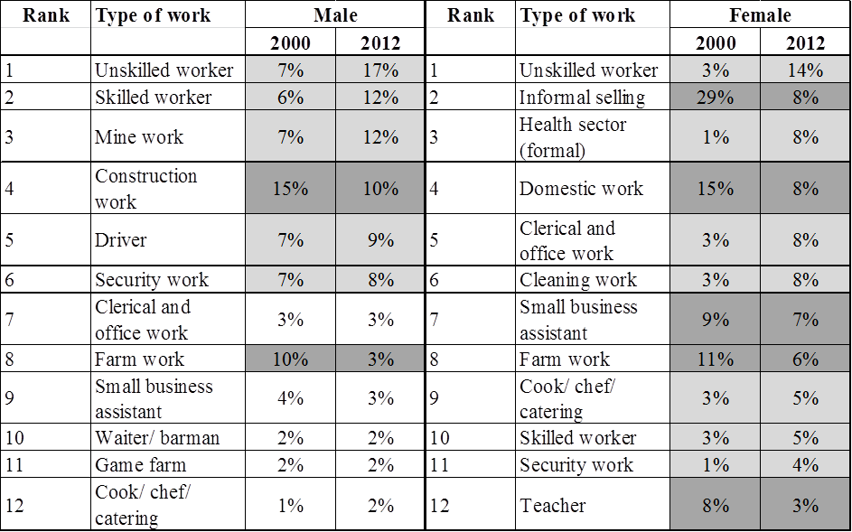
Type of work – male and female – Agincourt 2000 and 2012

Slide 14
Type of work – male and female – Agincourt 2000 and 2012

Slide 15
Trends 2000-2017 different migration types (SAPRIN)
N=300 000
Definitive
out-migration
Definitive
in-migration
Temporary
out-migration
Temporary
In-migration

Slide 16
Migrant Health Follow-Up Study (Agincourt)
Agincourt Health and Socio-Demographic Surveillance System
Non-migrants
Migrant Health Follow-Up Study (MHFUS)
3800 individuals aged 18 - 40
Migrants
Five data collection waves
(face-to-face and telephone)
Employment and residence history
SES and remittances
Health status: BP, BMI, HIV, Diabetes
Health-related behaviours
Health care utilisation

Slide 17
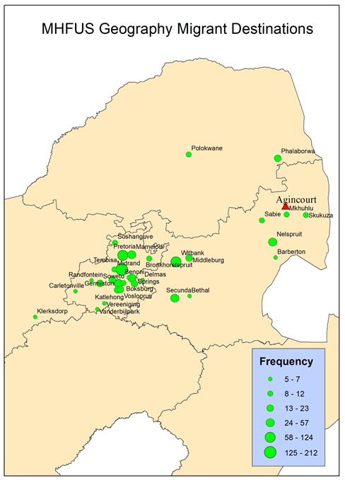
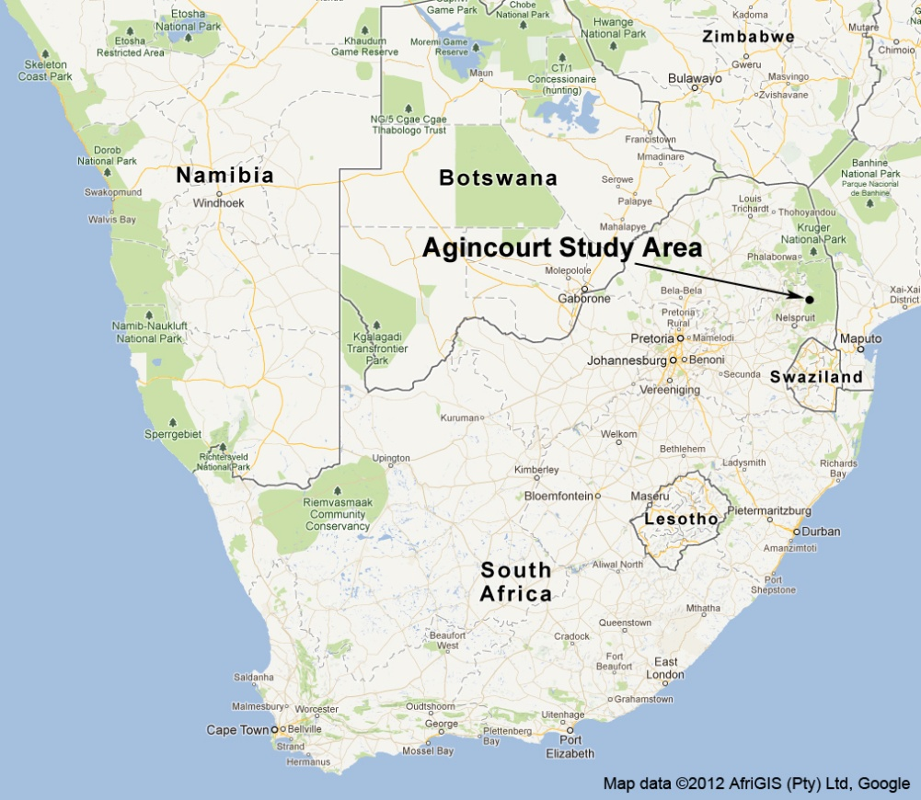
Agincourt study site and migrant destinations

Slide 18
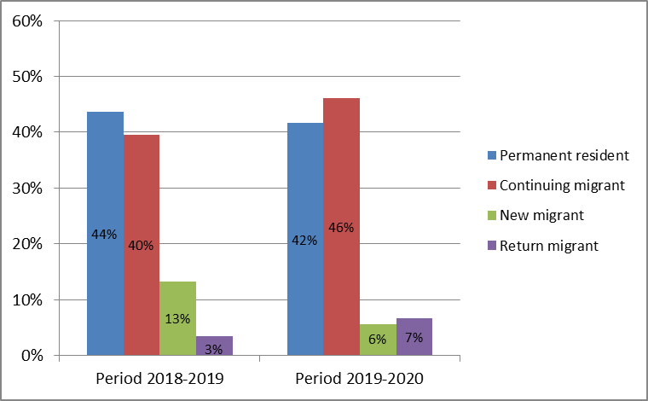
Migration status changes - 2018/2019 vs 2019/2020
MHFUS,
N=2971

Slide 19
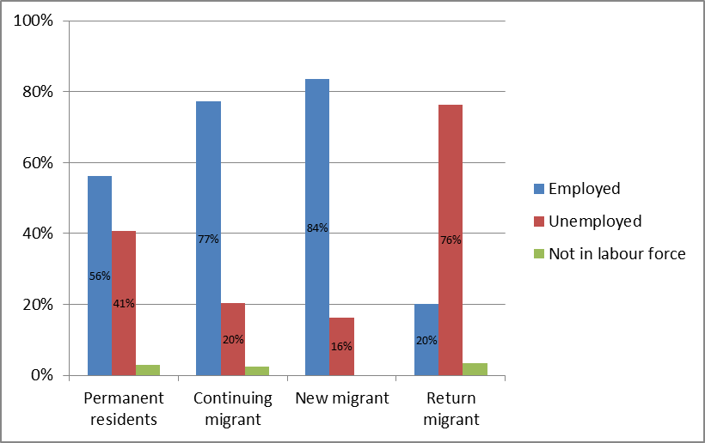
Employment status in 2020 among those who were employed in 2019, by migration status
MHFUS,
N=1360

Slide 20
Take-home messages
Temporary migration remains crucial for rural youth to enter employment
Type of work is changing, less farm work and more unskilled labour
Permanent migration trends reducing, temporary migration trends stable
Covid and lockdown impacted young people’s ability to migrate
We must make migration easier and safer to enhance the dividend of the youth bulge

