Slide 1
World Population Day 12 October, 2021
Diego Iturralde
Statistics SA

Slide 2
Prospects of a Youth Demographic Dividend
The Demographic Dividend
Population Dynamics of the youth (MYPE 2021) with emphasis on the youth and Covid-19

Slide 3
Demographic Dividend

Slide 4
Despite sustained growth in sub-Saharan Africa, two thirds of this region lives on less than $2 a day
Accelerated growth is required in order to make a profound change to the region
The experience in Asia and Latin America characterised by a drop in fertility which led to decreased youth dependency rates
These countries reacted to this by investing in health, education, enacting economic policies that created sustainable jobs and which led to the accelerated growth known as the Demographic Dividend

Slide 5
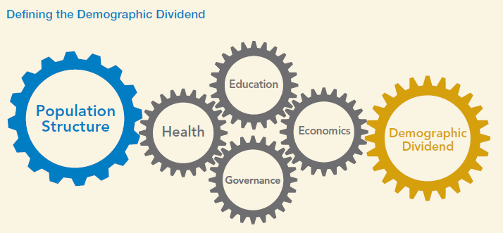

Slide 6
The model by Bloom et al indicates that in order to benefit from the dividend:
Countries must experience demographic change
Improve people’s health
Invest in education
Implementing economic and governance policies

Slide 7
Demographic Change
The first requirement for the dividend to take place is to lower fertility and mortality rates and create an age structure with reduced dependency
This was achieved by promoting family planning, birth spacing
Child survival would lead to smaller families
Girls education leads to postponement of marriage and childbearing

Slide 8
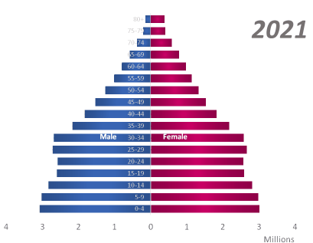
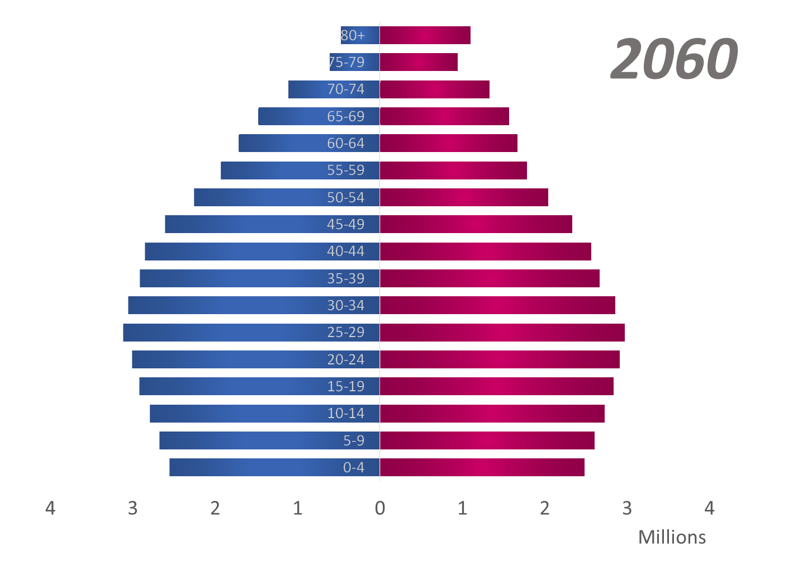

Slide 9
Health and Education
Investment in health and education are key for developing a skilled and health labour force
Promoting health allow children to perform better at school and to eventually contribute more productively to the labour force
Reproductive health services and health seeking behaviour to combat non-communicable diseases need to be promoted

Slide 10
Education enables people to become more skilled and to access high quality jobs which promote economic development
UNICEF recently claimed that each extra year of education equates to 10% increase in personal income

Slide 11
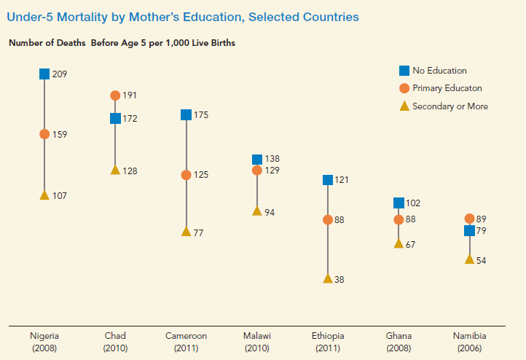

Slide 12
Job Creation
Africa’s challenge is that due to its young population it needs to create jobs at a similar rate to which the labour force is growing.
In order to do this the working age group (15-64) needs to be larger than either the youth (0-14) or the aged (65+)
Identify sectors of the economy that will drive economic growth

Slide 13
Ensure that skilled workers are available to fill key jobs in these sectors
Promote pro-growth economic policies as well as promoting traditionally male dominated careers to women
A balance must be reached between economic growth and an environment that enables job creation

Slide 14
Governance
It is critical that for all these investments to result in the benefits of the demographic dividend sound governance principles must be applied so that the impact of inflation, political instability and corruption to name a few, do not erode the gains made

Slide 15
A demographic dividend must be earned through investments in education, health of the youth, infrastructure in roads, power and water, political stability, fighting corruption as well as labour market policy reforms

Slide 16
Beyond the dividend
An emerging concept is that of the second demographic dividend and this applies to a case where all the conditions of the first dividend have been met which encourages people to accumulate more personal wealth
Since people live longer they are able to accumulate more wealth to support themselves in old age.

Slide 17
Research by Lee and Mason (2006) shows that in such cases people will invest more in each of their children and enable more resources to be made available to them which will result in the sustainability of the demographic dividend

Slide 18
Population Dynamics of the Youth in South Africa

Slide 19
COVID19 impact on the three major drivers of population movements
COVID-19
IMPACT
The ultimate purpose of the mid-year population estimates is to provide population estimates for policy making & planning. However, this objective cannot be addressed without taking into account the COVID-19 pandemic that has greatly affected the nation over the past sixteen months.
Fertility
The impact of COVID-19 on conception and subsequent fertility will only be reflected in the reported births of 2021.
Mortality
There has been approximately 62 000 COVID-related deaths reported by NDOH (DATCOV), whilst the MRC weekly deaths have reported more than180 000 excess deaths since March 2020.
There is a marked reduction in international migration, which is indicative of the COVID-19 travel restrictions globally over the past 16 months. Internal mobility in this period has mostly been temporary whilst the MYPE requires a more permanent act of migration.
Migration

Slide 20
The South African population in 2021 is estimated at
60, 1 Million
up by 604 281 (1,01% change)
from 2020 estimates
GP
KZN
WC
EC
LP
MP
NW
FS
NC
45,4%

Slide 21
Births are the main driver of population growth in South Africa.
COVID-19
IMPACT
Compared to previous years, deaths in 2021 are significantly higher as a result of the COVID-19 outbreak
Impact of births, deaths and migration on population, 2021
+0,13M
+1,17M
NET
MIGRATION
-0,70M
DEATHS
60,14M
59,54M
BIRTHS
SA 2020
SA 2021
*data based 2021 series

Slide 22
More than half of the population live in 3 provinces (GP, KZN and WC)
GP remains SA’s most populated province with approximately 15,8 million people (26,3%) living in this province.
Mid-year population estimates for South Africa by province, 2021
GP
KZN
WC
EC
LP
MP
NW
NC
FS
26,3%
19,1%
11,8%
11,1%
9,9%
7,9%
6,9%
4,9%
2,2%
57,2%
57,1%

Slide 23
Children and youth amount to nearly 38 million in SA
South Africa is a demographically youthful population with a median age of 28
Population age structure 5 year groupings, 2021
SA median age is 28 years
Elderly 60+
5,5M (9.1%)
Children 0-14
17,0M (28.3%)
Youth 15-34
20,6M (34.3%)
Adults 35-59
17,0M (28.3%)

Slide 24
Growth rates for specific age groups (2002-2021)
Due to the impact of HIV and AIDS, there was negative growth among children under 15, but with the introduction of PMTCT and ART programs there was a reverse in the growth rate among children from negative to positive.
High mortality levels among the elderly during the COVID-19 pandemic, lead to drastic decline in growth rate among elderly from 2,9% to 1,5% for the period 2020–2021. Similarly, the age group 25-59 also saw a decline in the rate of growth for the period 2020–2021.
The shifts in the demographic age and sex profile of South Africa due to the COVID-19 pandemic must be taken into consideration when planning for the future health, economics and welfare.

Slide 25
Approximately 51,1% (30,8 million) of the population is female.
South Africa’s population by gender, mid-2021
48,9%
60,14
million
51,1%
Male
Female
(29,4M)
(30,8M)
Notes:
Amongst youth 50,45% is Male and 49,55% is Female

Slide 26
The Population Pyramid is reflective of a youthful population.
COVID-19
IMPACT
Whilst COVID-19 has had a devastating social and economic impact, the change in population structure is minimal. However the indicators of mortality, though not reflected here, are impacted.
SA age structure by 5 year groups, 2021
There is a significant youth bulge aged 25-39

Slide 27
The population profile differs significantly by province.
COVID-19
IMPACT
Whilst COVID has had a devastating social and economic impact, the change in population structure is minimal. However the indicators of mortality, though not reflected here, are impacted.
SA age structure by 5 year groups, 2020 for selected provinces
EC
80+
GP
80+
75-79
75-79
70-74
70-74
65-69
65-69
M
60-64
F
GP has a higher proportion of adults aged 25-39 when compared to EC, which has a higher proportion of children aged 0-14 and elderly within the province
M
60-64
F
55-59
55-59
50-54
50-54
F
F
45-49
45-49
40-44
40-44
35-39
35-39
30-34
30-34
25-29
25-29
20-24
20-24
15-19
15-19
10-14
10-14
5-9
5-9
0-4
0-4

Slide 28
Child dependency is on the decline as the fertility rate declines and life expectancy rises. Old age dependency increased when compared to 2002 due to increase in life expectancy post 2006.
Improved access and uptake of ARVs in SA has enabled HIV positive people to live longer and healthier lives leading to an increase in the HIV population over time.
Old Age and Child Dependency Ratio’s 2002 - 2021
Child
Dependency
Old Age
Dependency
per 100
per 100
Child dependency is on the decline as the fertility rate declines and life expectancy rises.
per 100
per 100
*The dependency ratio is an indicator of the potential dependency burden of children (0-14) and the elderly (65+) on those who are of economically productive ages (15-64)

Slide 29
LP has the highest proportion of children under 15 whilst Gauteng has the highest proportion of Youth and Adults (15-59)
Impact of births, deaths and migration on population, 2021
Children
Adults(15-59)
Elderly 60+

Slide 30
Fertility
(Births)

Slide 31
On average, a woman will give birth to 2,31 children in her lifetime.
Total Fertility Rate, 2002-2021
The total fertility rate peaked in 2008 at 2,66 and is declining
59,54M
Replacement Fertility Rate 2,1
There is a general decline in Total fertility in SA
Current assumptions of national and provincial fertility are based on patterns seen in published births data currently available (VRS).
SA 2020
SA 2021
*data based 2021 series

Slide 32
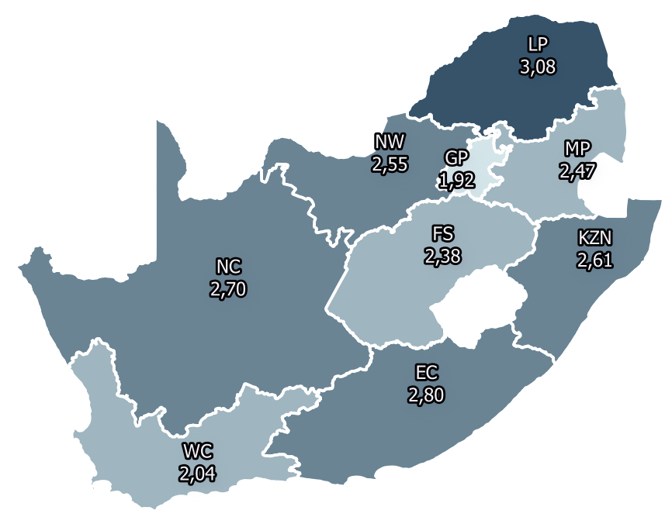
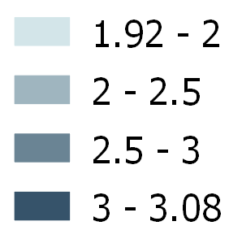
Demographic drivers of fertility, mortality and migration over time determines provincial population age and sex profiles
Less urbanised provinces of LP and EC indicate higher fertility rate
Fertility rate by province 2016-2021

Slide 33
Births are the main driver of population growth in South Africa.
Total Births for the period 2002–2021

Slide 34
The NW has shown larger drops in fertility relative to other provinces
Less urbanised provinces of LP and EC indicate higher fertility rate
Fertility Rate by Province, 2001 -2021
2001-2006
2006-2011
2011-2016
2016-2021
3.2
3.3
3.1
2,6
Current assumptions of national and provincial fertility are based on patterns seen in published births data currently available (Vital Records System).
2.2
1,9

Slide 35
Mortality
(Deaths)

Slide 36
There was a significant rise in deaths in 2021, approximately 34%.
COVID-19
IMPACT
South Africa experienced both the 1st and 2nd wave of the COVID-19 pandemic in the year 2020/21 as well as the beginnings of the 3rd wave in June 2021. This resulted in a significant increase in the crude death rate (CDR) within a year from 8,7 deaths per 1 000 people in 2020 to 11,6 deaths per 1 000 people in 2021.
Estimated deaths and total life expectancy at birth over time, 2002–2021
Life Expectancy
59,54M
SA 2020
SA 2021

Slide 37
Total Life Expectancy (LE) at birth declined from 65.5 to 62 years (3,5 yrs)
COVID-19
IMPACT
Decline in Life expectancy is due to the rise in excessive deaths during COVID-19 pandemic
Total life expectancy at birth by sex over time, 2002-2021
Female
(3,8yrs)
Total
(3,1yrs)
Male
The decline in LE at birth in 2021 reflects the impact of a sudden epidemic such as COVID-19 on mortality.
The decline in Life Expectancy between 2002 and 2006 can be attributed to the impact of HIV and AIDS

Slide 38
Free State has a significantly lower life expectancy than the SA average
COVID-19
IMPACT
The impact of COVID-19 deaths occurring since March 2020 have been incorporated into the provincial estimation and slowed down the improvement in LE over the 5-year period
Life Expectancy by province 2016 -2021
9 year gap in female LE between FS and WC
70,3
66,5
67,7
65,0
66,0
64,9
63,6
64,3
64,2
63,1
Female
61,4
60,8
61,2
57,4
57,6
57,7
58,7
Male
55,5
*

Slide 39
Infant mortality rate has declined over time to 24.1 in 2021.
COVID-19
IMPACT
The child sparing pattern of COVID-19, has thus far made no significant impact on child mortality levels in the country
IMR and U5MR per 1000 live births over time, 2002-2021
59,54M
U5 Mortality Rate
There has been an overall decline in child mortality in South Africa since 2006.
Infant Mortality Rate
SA 2020
SA 2021

Slide 40
8,23 million people are living with HIV in 2021
COVID-19
IMPACT
The presence of a competing pandemic such as COVID-19 in South Africa does present challenges likely to hamper progress in the eradication of HIV and AIDS
Number of people living with HIV, 2002-2021(millions)
8,23
Improved access and uptake of ARVs in SA has enabled HIV positive people to live longer and healthier lives leading to an increase in the HIV population over time
Millions

Slide 41
Post 2006 HIV-related deaths declined, however there is a slight increase in 2021
COVID-19
IMPACT
The presence of the COVID-19 pandemic has hampered the ability of the health sector to ensure continuity of care and use of ART during the pandemic
Total number of deaths estimated over time vs HIV-related deaths in thousands, 2002-2021
Total Deaths
HIV Related Deaths

Slide 42
Migration

Slide 43
The period 2016 -2021 saw a reversal of the earlier growth in net international migration
COVID-19
IMPACT
Net international migration rate can be volatile, impacted significantly by economic and policy changes, as encountered in the recent outbreak of COVID-19 in March 2020. Due to the international travel ban, travel was brought to an abrupt halt. The pandemic affected 16 of the 60-month period (2016-2021)
Net International migration 2001 - 2021

Slide 44
For the period 2016 -2021, Net migration is expected to be 852 992
COVID-19
IMPACT
Net migration rate can be volatile, impacted significantly by economic and policy changes, as encountered in the recent outbreak of COVID-19 in March 2020. Due to the international travel ban, travel was brought to an abrupt halt. The pandemic affected 16 of the 60-month period (2016-2021)
International migration by population group 2016-2021
Africa
894 365
White
Total Deaths
HIV Related Deaths
90 957
Asia
49 584

Slide 45
Over the period 2016 to 2021 five provinces had net inflows of people. GP attracted the most migrants.
COVID-19
IMPACT
Movement made during lockdown often constitutes a temporary one, whilst interprovincial migration in the MYPE constitutes movements that are consistent with a more formal definition of migration
Net migration 2016-2021 by province
Net Migration
Out Migration
In Migration
GP
WC
NW
MP
NC
FS
KZN
LP
EC

Slide 46
GP is estimated to experience the largest net inflow of migrants of approx. 991 590 net migrants
COVID-19
IMPACT
The reduction in international migration to receiving provinces is indicative of the post COVID-19 travel restrictions
Net migration 2016-2021 GP as a destination province
GP as a destination province
The economic strength of Gauteng influences its attractiveness to migrants especially from Limpopo (354 909)
GP is the preferred destination of international migrants

Slide 47
WC is estimated to experience the second highest net inflow of migrants for the period 2016 to 2021 of
approx. 470 657
COVID-19
IMPACT
The reduction in international migration to receiving provinces is indicative of the post COVID-19 travel restrictions
Net migration 2016-2021: WC as a destination province
WC as a destination province
Opportunities for employment, study and quality of life play an important role amongst the push-pull factors resulting in high flow of migrants to WC.

Slide 48
Attainment of the Demographic Dividend, although not likely, should be contextualised
Time needed for education to provide skilled workers
Double impact of HIV/Aids and Covid is detrimental to the workforce
Systemic nature of unemployment in SA needs to be broken
Economic growth should be linked to future industries in the world of work
Adherence to corporate governance is the glue that keeps all this together and assures better lives in our communities
Ultimately for the youth to reach their potential and population to develop as anticipated, Demography Matters!

