Slide 1
The Demographic Impact of Covid-19 and Response Measures in India
Webinar On Population Matters:
The Demographic Impact of Covid-19 and Response Measures in BRICS Countries
8th December 2021
By:
Dr. Sujeet Kumar Singh
Director – National Centre for Disease Control,
Ministry of Health and Family Welfare, Government of India

Slide 2
Countries recording high cases
(As on 6th Dec 2021)
S. NO. | Country | Total Cases | Daily Cases | CPM |  | Total Deaths | Daily Deaths | DPM | CFR |  | Percentage of Partially Vaccinated Population | Percentage of Fully Vaccinated Population
 | World | 266,114,650 | 424,130 | 34,140 |  | 5,270,781 | 4,245 | 676 | 1.98% |  | - | -
1 | UK | 10,464,389 | 43,992 | 153,000 |  | 145,605 | 54 | 2,129 | 1.39% |  | 76.38% | 69.51%
2 | France | 7,917,264 | 42,252 | 120,912 |  | 119,535 | 29 | 1,826 | 1.51% |  | 80.19% | 78.52%
3 | Germany | 6,179,839 | 35,983 | 73,424 |  | 103,604 | 74 | 1,231 | 1.68% |  | 71.62% | 68.72%
4 | USA | 49,969,856 | 35,065 | 149,713 |  | 808,763 | 155 | 2,423 | 1.62% |  | 70.36% | 59.45%
5 | Russia | 9,801,613 | 32,602 | 67,123 |  | 281,278 | 1,206 | 1,926 | 2.87% |  | 45.67% | 38.87%
6 | Netherlands | 2,751,954 | 23,078 | 160,100 |  | 19,668 | 26 | 1,144 | 0.71% |  | 76.90% | 73.83%
7 | Poland | 3,671,421 | 22,389 | 97,160 |  | 85,675 | 45 | 2,267 | 2.33% |  | 55.04% | 53.87%
8 | Turkey | 8,901,117 | 19,357 | 103,945 |  | 77,830 | 185 | 909 | 0.87% |  | 67.69% | 60.74%
9 | Italy | 5,109,082 | 15,021 | 84,679 |  | 134,195 | 43 | 2,224 | 2.63% |  | 78.30% | 74.81%
10 | Vietnam | 1,309,092 | 14,314 | 13,279 |  | 26,260 | 199 | 266 | 2.01% |  | 73.75% | 52.81%
11 | South Africa | 3,031,694 | 11,125 | 50,215 |  | 89,966 | 1 | 1,490 | 2.97% |  | 29.57% | 24.77%
12 | Czechia | 2,240,721 | 10,967 | 208,685 |  | 33,665 | 48 | 3,135 | 1.50% |  | 62.62% | 59.90%
*Highlighted cases and deaths indicates countries with highest cases and deaths.
**Vaccination coverage highlighted in red indicates countries with lowest vaccination rates, whereas green indicates countries with highest vaccination rates.

Slide 3
India’s Public Health Response
(Status as on today)
Laboratory Support | Total Tests Conducted | 64,94,47,014
 | Tests conducted in last 24 hours | 10,79,384
 | Overall Case Positive Rate | 5.34%
 | Case positivity in last 24 hours | 0.63%
 | Govt. Testing Laboratories | 1,356
 | Pvt. Testing Laboratories | 1,723
 | Total Laboratories | 3,079
Summary of Cases
 | As on 07.12.2021 | As on 06.12.2021 | Change during last 24 hours
Total Active Cases | 95,014 | 98,416 | -3,402
Total Recovered | 3,40,79,612 | 3,40,69,608 | 10,004
Total Cases | 3,46,48,383 | 3,46,41,561 | 6,822
Doubling Rate (7 Days) | 2,774 | 2765 | 8
Total Deaths | 4,73,757 | 4,73,537 | 220
Case Fatality Rate (CFR) | 1.37% | 1.37% | 0
Active cases constitute 0.27 % & Recovered cases constitute 98.36 % of total cases

Slide 4
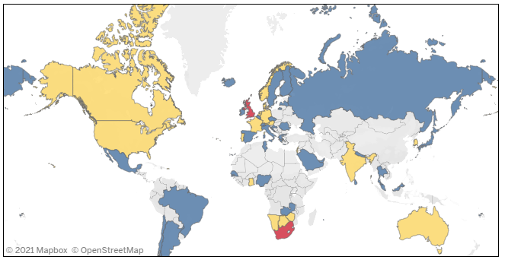
Global mapping - Omicron Variant
(As on 7th Dec 2021)
53
Countries Infected
1,092
Total Omicron Cases
55,991
Probable Omicron Cases
Total Cases

Slide 5
Omicron Cases in India
India :
Total cases: 23
Affected States: 5

Slide 6
Cases Across India Vs Impact on GDP
99,763
Active Cases (0.29%)
TOTAL CASES
34.6 Million
DISCHARGED
34.0 Million
(98.35%)
DEATHS
0.47 Million
(1.36%)
Approximately 88 per cent of all Covid-19 deaths in the country are in the age group 45 years and above
Source: MoHFW (https://www.mohfw.gov.in/)
India’s swift and substantial policy responses to the pandemic, including fiscal support and economic reforms, are underpinning a rebound in growth that’s now forecast to be one of the fastest of all major economies. (Source: International Monetary Fund)
Notes:
IMF Article: https://www.imf.org/en/News/Articles/2021/11/02/na111121-indias-economy-to-rebound-as-pandemic-prompts-reforms

Slide 7
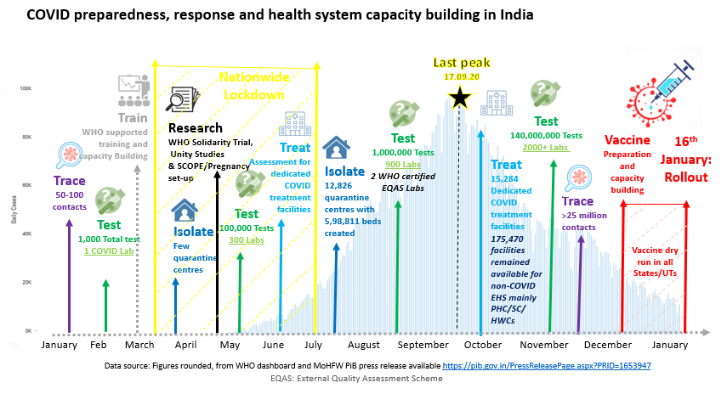
COVID- 19 Pandemic- India’s response
Highest recovery rate in the world (>98%)- India has not only flattened the curve, but hammered it down
Case fatality rate is low at 1.4%
Largest vaccination drive in the world with indigenous vaccines

Slide 8
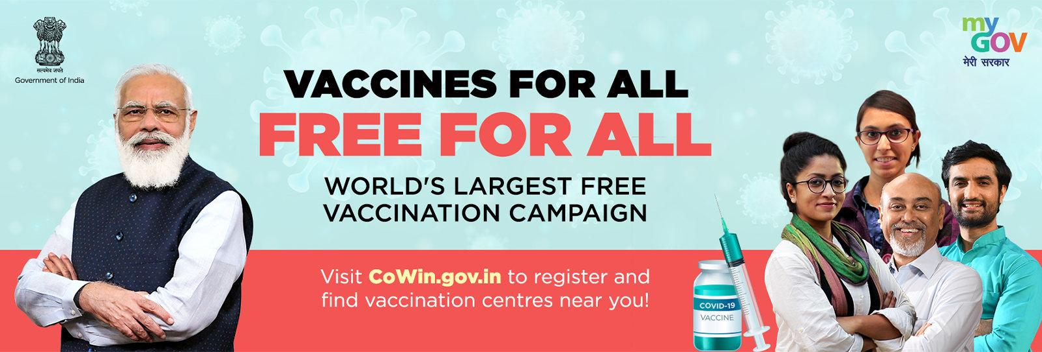
1,24,10,86,850
Vaccination Status
Vaccine Doses Administered (Source: MoHFW Website, Till: 01.12.2021)

Slide 9
COVID 19 Response Measures - India’s Priority
1
Governance
2
Health Workforce
3
Robust Vaccine Delivery
360 Degree Multi-level Response
4
Oxygen, Diagnostic & PPE
5
Financing
6
Information System
7
Community Involvement

Slide 10
Existing strategies / interventions to Mitigate COVID-19
1
Political Will, Structured governance systems
2
Rational deployment, Task shifting, Capacity building, Education/training infrastructure.
Community Involvement
Governance
3
Robust Vaccination Drive
Information
System
Health
Workforce
4
Essential Supplies - Oxygen, Diagnostic & PPE
Financing
Vaccine
Essential
Supplies
5
Insurance Scheme - Pradhan Mantri Garib Kalyan Yojana / Package
6
Robust IT initiatives for Service management systems
7
Community Involvement- “HAR GHAR DASTAK”

Slide 11
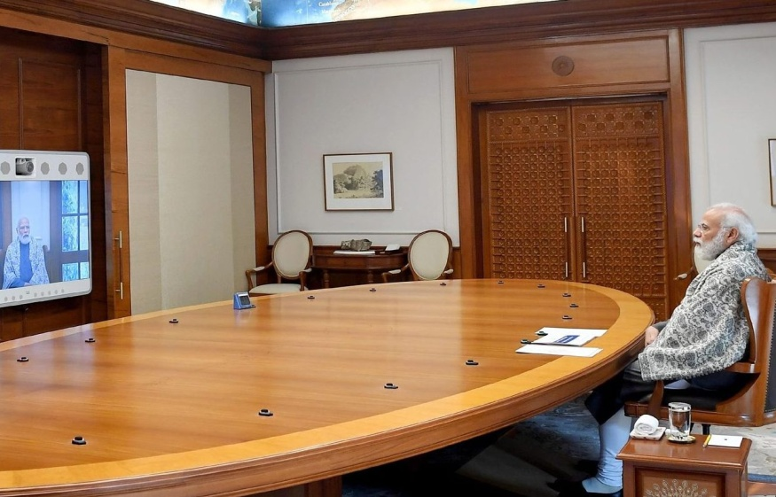
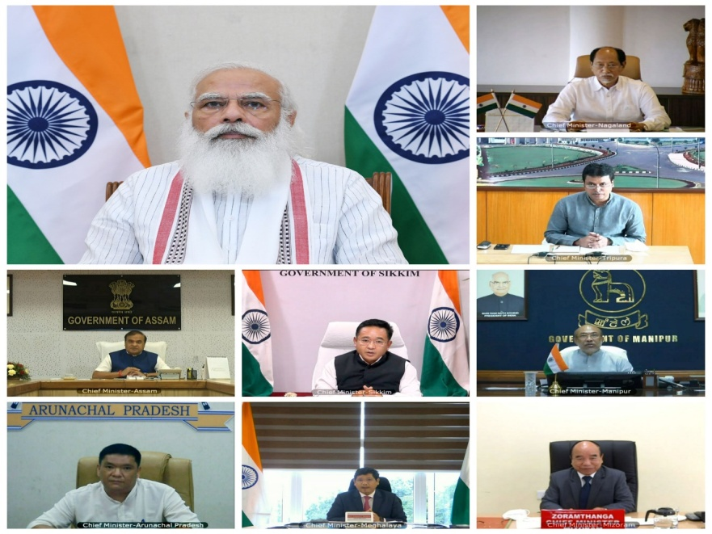
Existing strategies / interventions to Mitigate COVID-19
Hon’ PM daily Monitoring & Oversight
Continuous engagement with Chief Ministers and State Health Ministers
Group of Ministers (GoM) Monitoring
MoHFW Joint Monitoring Group
WHO Incident Management team
Governance

Slide 12
Contd… Existing strategies / interventions to Mitigate COVID-19
Redeploying the staff from non-affected areas and facilities.
Utilizing fit retirees for non-COVID services roles.
Hiring non-governmental, and private sector health workforce
Substantive health insurance package for health care providers.
Virtual training packages for the health workforce
Utilizing state digital platforms for trainings and orientation of the staff (iGOT)
Health
Workforce

Slide 13
Contd… Existing strategies / interventions to Mitigate COVID-19
Covaxin is an indigenous inactivated vaccine
The vaccine has been found to be 78% effective in the phase 3 clinical trial results.
There are six (6) indigenous manufacturers in India.
Till 26th November 2021, more than 1.2 billion doses of Covid-19 vaccine have been administered across the country to the eligible population (persons aged 18 years & above).
Of this, 776.4 million crore doses are 1st dose (82.7% population) and 426.2 million doses are 2nd dose (45.4% population).
Source: Response Received from ICMR.
Vaccine Exported Under Vaccine Maitri
A total of 70.77 million doses of Covid-19 vaccines have been supplied to 95 countries (as of 22nd Nov, 2021).
This includes 12.71 million doses as grant by the Government of India, 38.19 million doses as commercial supplies by manufacturers and 19.86 million doses to COVAX.
Source: Ministry of External Affairs (MEA) Website. (https://www.mea.gov.in/vaccine-supply.htm )
Vaccines

Slide 14
Contd… Existing strategies / interventions to Mitigate COVID-19
Oxygen Expresses deliver nearly 14500 MT of Liquid Medical Oxygen to the nation (Source: https://pib.gov.in/PressReleasePage.aspx?PRID=1720925)
Make-in-India Oxygen Concentrators to meet the emerging healthcare requirements to combat the COVID 19 epidemic. (Source: https://www.pib.gov.in/PressReleasePage.aspx?PRID=1720877)
644.6 Million test done till date. (Source: https://www.mygov.in/covid-19)
From initially being an importer to becoming a manufacturer of PPE,
India is now one of the major global exporters for PPE kits amidst the Covid-19 crisis.
Essential
Supplies
“A potent example of ‘self-reliance”

Slide 15
Contd… Existing strategies / interventions to Mitigate COVID-19 Impact
The Pradhan Mantri Garib Kalyan Yojana / Package is a comprehensive relief package of Rs 1.70 Lakh Crore (22.37 Billion USD) scheme for the poor to help them fight the battle against Corona Virus.
The Package includes - Insurance cover of Rs 5 million per health worker, 800 million economically backward people will get food relief martials, 200 million women, 87 million farmers, 18.2 million construction workers and 30 million senior citizen will get financial benefits who are most affected by the COVID-19 pandemic.
(Source: https://www.india.gov.in/spotlight/pradhan-mantri-garib-kalyan-package-pmgkp).
Recent health budget also witnessed a 137% increase in health and wellness budget.
Financing

Slide 16
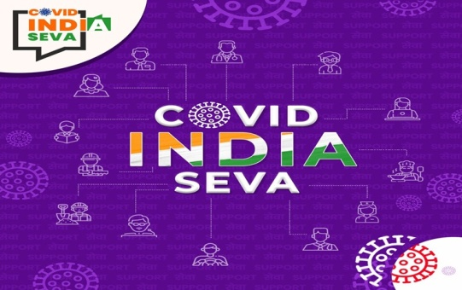
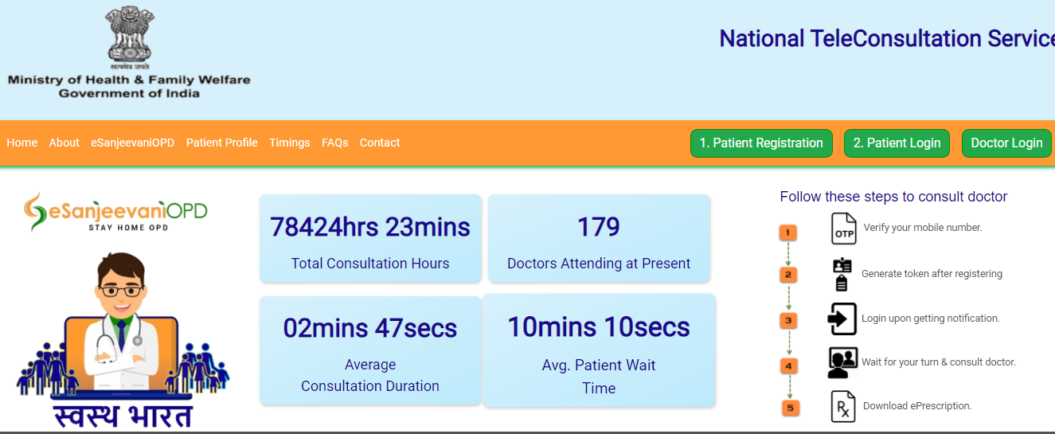
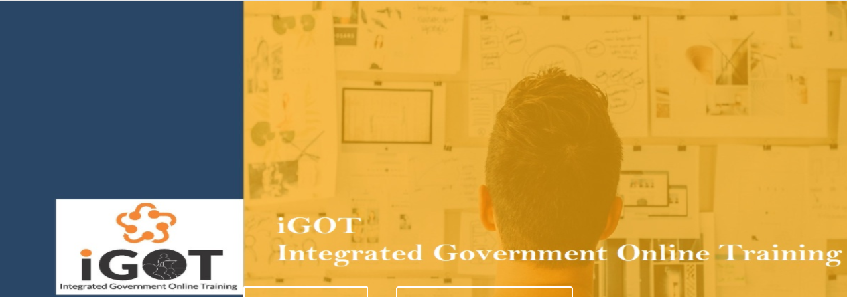
Contd… Existing strategies / interventions to Mitigate COVID-19
Amidst pandemic, India worked on new set of e-Governance solutions
Tele Consultation services through e-Sanjeevni
Pan india telemedicine network- in 150,000 Health and Wellness Centres
Integrated Government Online Training Platform (iGOT)
Aarogya Setu app for contact tracking and contact tracing
COVID India Seva- real time grievance redressal
Cowin app- track Covid vaccine roll out
Information
System

Slide 17
Contd… Tracking Software (CoWIN) - Features
Creation of Users
Registration of Covid-19 Vaccination Centres (CVCs) and session sites
Registration of Beneficiaries & Scheduling of Appointments
(Admins, Supervisors and Vaccinators)
Planning and Scheduling of Vaccination Sessions
Certification
(Also for National & International Travel)
Implementation of Vaccination Process

Slide 18
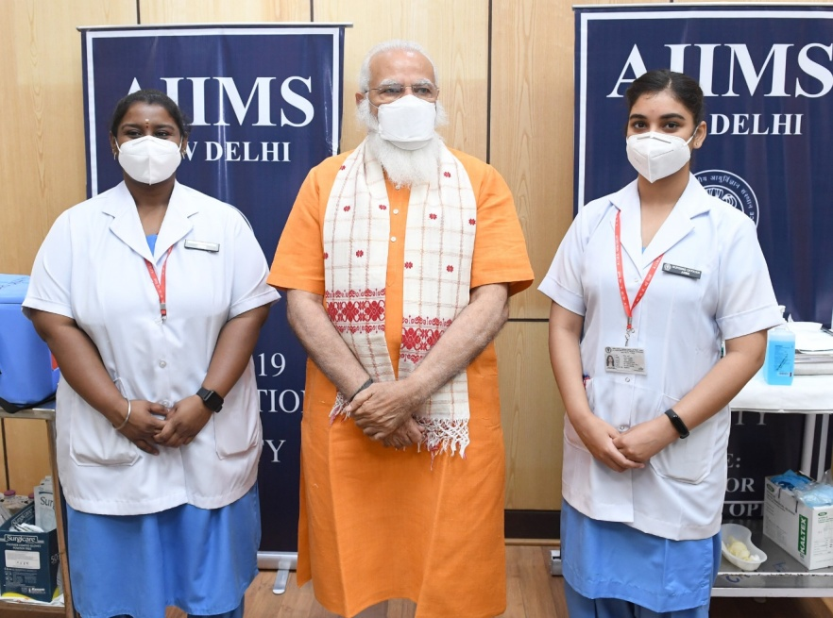
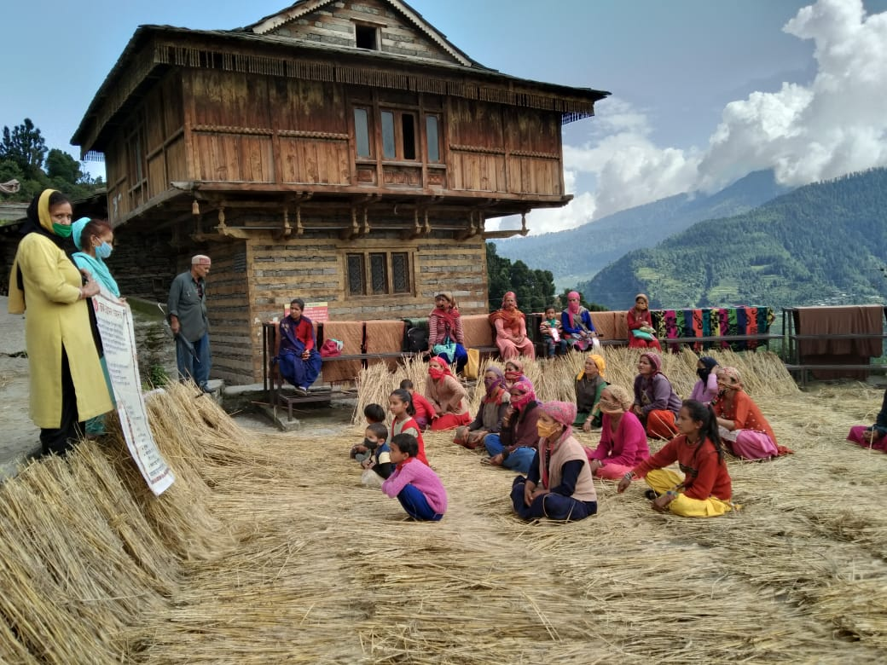
Contd… Existing strategies / interventions to Mitigate COVID-19
Prime Minister Narendra Modi announced the launch of door-to-door Covid-19 vaccination campaign 'Har Ghar Dastak'
Modified Outreach sessions with staggered approach
Utilization of mass media and digital platforms
Community Involvement

Slide 19
If we want the world to be a better place to live, we have to treat it as one unit.
If we want economic growth to be pervasive, we have to make people its partners.
If we want the process of development to be sustainable, we have to work with the environment.
-Shri Narendra Modi
Thank You

