Slide 1
NATIONAL YOUTH POLICY 2020-2030 AND THE DEMOGRAPHIC DIVIDEND 12 October 2021

Slide 2
1. INTRODUCTION
Africa is the most youthful continent worldwide. In 2020, 540.8 million 0-14 year olds and 454.5 million 15-34 year olds.
In South Africa, young people constitute nearly a third of the population.
One (1) in four (4) persons will be between the ages of 15-29, between now and 2030.
This offers an opportunity for a demographic dividend,
However, youth continue to experience challenges and exclusion which have been made worse by the outbreak of Covid-19 pandemic.
Lack of investment in youth development, will result in disastrous effects that would certainly reverse the country’s social and economic efforts.

Slide 3
It is a
Demographic DIVIDEND
not a
Demographic
GIFT
Notes:
If you open a bank account without making any deposits, you cannot expect to go and ask for the interest / dividends you have earned.
In fact you might find that you owe bank charges.

Slide 4
1. Background to NYP 2030
Over the last decades, SA government developed policies, strategies, and programmes towards advancement of the youth. This is in order to create an environment that enables young people of South Africa to reach their potential through specifying the policy priorities and interventions that will act as catalysts to help clear critical blockages for youth to achieve positive development.
These interventions aim to enable optimal development of young people aged 14-35 years old,
In developing the NYP2030, the DWYPD partnered with the UNFPA and NYDA.
The NYP2030 is a cross-sectoral policy aimed at redressing the wrongs and injustices of the past, whilst addressing persistent, new and emerging challenges of the country’s diverse youth.
It centrally places the youth as key players in their own development and in advancing development of their communities, the nation, the continent and globe.
The policy outlines policy priorities and proposes key interventions geared towards changing the lives of the youth for the better.

Slide 5
3. NYP2030 POLICY PRIORITIES
The policy identifies the policy priorities with key interventions aimed at improving the prospects of youth towards attaining positive youth development outcomes:
Quality Education, Skills and Second chances;
Economic Transformation, Entrepreneurship & Job creation​;
Physical and Mental Health promotion;
Social Cohesion and Nation Building; and
​Effective and responsive youth development machinery.
The 4IR pillar cuts across all the 5 policy priorities.
SECRET

Slide 6
Pillar 1

Slide 7
Pillar 2

Slide 8
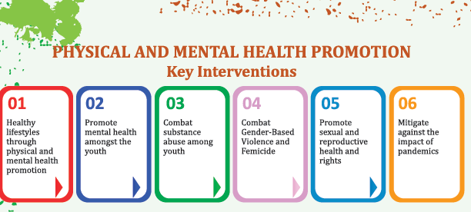
Pillar 3

Slide 9
Pillar 4
SOCIAL COHESION AND NATION BUILDING
Entrench social cohesion and nation building through multi-pronged approach
Adequately resource and scale up the National Youth Service
Expose youth to positive constitutional values that promote South African identity
Support the youth in confronting systemic racism within society.
Foster leadership and active citizenry amongst the youth (including voting)
Expand and adequately resource compulsory school and community sports
Utilise the 4th Industrial Revolution in fostering Social Cohesion, and Nation building

Slide 10
Pillar 5

Slide 11
Conditions for reaping a demographic dividend:
an environment where high-quality health and education provision is possible to facilitate demographic transition;
access to reproductive health services and facilities by all, especially the youth;
sufficient flexibility in the labour market to allow its expansion through creation of adequate employment opportunities;
macroeconomic policies that permit and encourage investment; and
access to adequate saving mechanisms plus confidence in domestic financial markets.

Slide 12
Concluding remarks
The policy is a key advocacy tool towards commitment to action by all stakeholders.
We need to strengthen interventions especially along health; education and employment to reap the demographic dividend.
Mainstreaming youth development = Mainstreaming the Demographic Dividend into our plans and programmes.
Continued advocacy and policy dialogues important.
Youth-centric messaging is important to ensure we reach our target group.

Slide 13
THANK YOU
13

