Slide 1
NPO roles and responsibility in poverty alleviation, employment creation, service and community empowerment
NPO WEBINAR
03 NOVEMBER 2020
BUILDING A CARING SOCIETY. TOGETHER.
www.dsd.gov.za

Slide 2
NPO REGISTER
Total Registered | Non-Compliant | Compliant | Not due for reporting
233 180 | 149 757 | 54 492 | 28 931

Slide 3
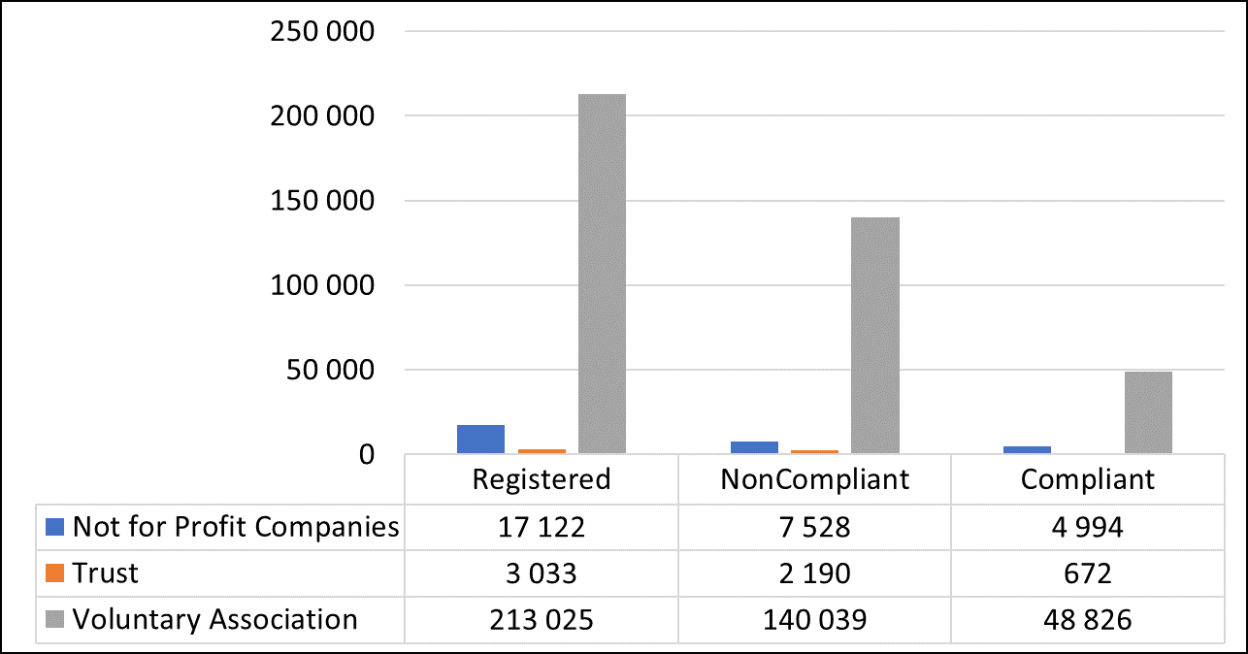
NATIONAL REGISTER BY LEGAL FORM
BUILDING A CARING SOCIETY. TOGETHER.
www.dsd.gov.za

Slide 4
NATIONAL REGISTER BY SECTOR
Sector | % | Registered | Non-Compliant | Compliant
Social Services | 39.0 | 86 062 | 55 285 | 22 402
Development and Housing | 22.4 | 59 642 | 35 619 | 13 050
Religion | 13.5 | 32 809 | 20 918 | 7 757
Culture and Recreation | 7.4 | 16 963 | 10 395 | 3 528
Education and Research | 5.9 | 11 261 | 8 254 | 2 528
Health | 6.5 | 14 379 | 11 104 | 2 567
Law, Advocacy | 2.3 | 5 099 | 3 565 | 1 087
Environment | 1.1 | 2 408 | 1 651 | 526
International | 0.1 | 103 | 77 | 19
Business and Professional Associations, | 1.0 | 2 657 | 1 584 | 644
Philanthropic intermediaries and voluntarism promotion | 0.9 | 1 797 | 1 305 | 384
TOTAL |  | 233 180 | 149 757 | 54 492
BUILDING A CARING SOCIETY. TOGETHER.
www.dsd.gov.za

Slide 5
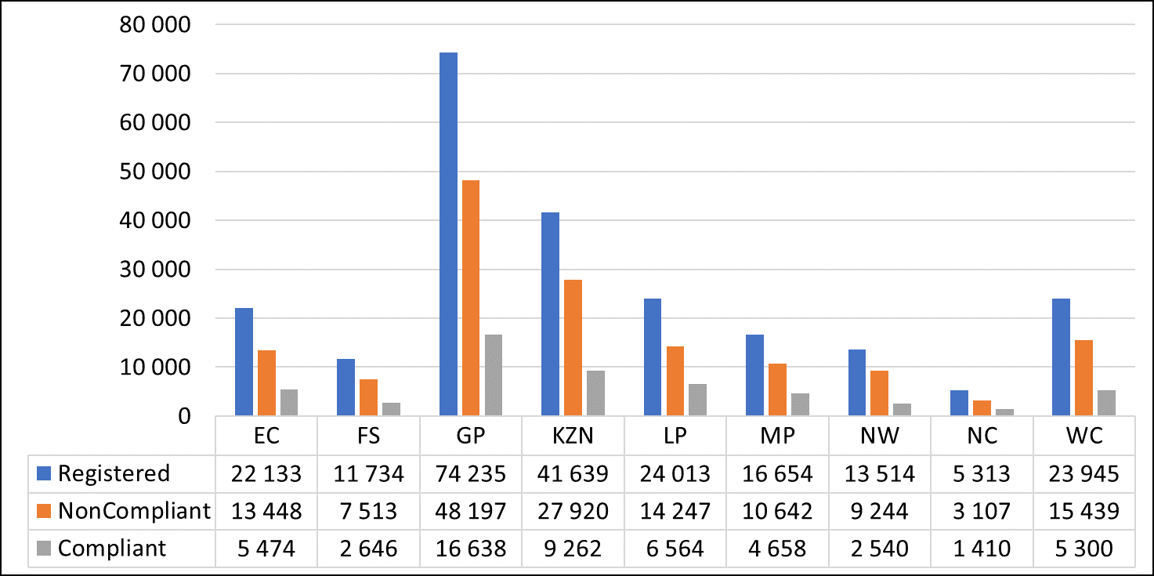
NATIONAL REGISTER BY PROVINCE
BUILDING A CARING SOCIETY. TOGETHER.
www.dsd.gov.za

Slide 6
RESPONSIBILITY OF THE NPO DIRECTORATE
Registering organisations as NPOs
Ensuring NPOs submit their annual reports
Maintaining an NPO Register
Ensuring NPOs understand and meet their obligations in terms of NPO Act
Our role includes

Slide 7
THE IMPORTANCE AND ROLE OF NPOS IN SOUTH AFRICA
NPOs in South Africa promote developmental programmes such as social services, education, environment, research, advocacy and good governance etc.
Promote community empowerment and contribute to building healthy communities.
NPOs contribute to socio-economic stability and mobility although very limited (NPOs participate in employment creation)

Slide 8
A STRONG NONPROFIT SECTOR IS KEY TO THRIVING COMMUNITIES
Non-profit organisations (NPOs) have played a critical part in trying to resolve the challenges and inequalities prevalent in South African society, but they are facing a future with increasingly limited funding and support within a fragile economy.
Traditionally the role of NPOs is associated with social development services (As demonstrated in the NPO register, the highest number of NPOs per sector are social services)
For NPOs to survive the in the new context (4IR, COVID-19, dwindling international support) they need to adapt and find their niche in the new economy or new normal by identifying economic opportunities i.e. Economic Recovery Plan
Perhaps this evolution is needed to ensure NPOs are able to deliver more value over the longer term
NPOs cant depend only on foreign donors and government.
They must directly participate in the economy, produce products that can be used by local community and can be exported.
Can provide alternative to current business practice and cooperatives.
Remember NPOs are allowed to make profit, however the profit cant be shared amongst office bearers but should be invested back to the community

Slide 9
THE CHANGING ROLE OF THE NPO SECTOR
The landscape:
Prior to 1990:NPOs had a key part in defending the rights of disadvantaged communities and delivering public services such as education, health care and welfare where the apartheid state had refused to do so.
Post-1994: (transitional period), the sector followed a more conciliatory and collaborative approach, with numerous NPOs working side by side with government to draft the new constitution and develop a constitutionally aligned legislative framework. I.e. NPO Act
The funding landscape changed, too, in that resources were allocated through bilateral arrangements between the South African government and funders. This impacted on the shape and nature of the relationship between government and NPOs as well as on the capacity of NGOs.
Post-2000: NPOs increasingly focused on service delivery. The period also saw a sharp decline in funding and increasing competition for funds and impairing the sustainability of many organisations.

Slide 10
THE CHANGING ROLE OF THE NPO SECTOR
In the years prior to 1990
NPOs had a key part in the struggle against apartheid, defending the rights of disadvantaged communities and delivering public services such as education, health care and welfare where the apartheid state had refused to do so
post-1994 transitional period
The sector followed a more conciliatory and collaborative approach, with numerous NPOs working side by side with government to draft the new constitution and develop a constitutionally aligned legislative framework. I.e. NPO Act
Post-2000
NPOs increasingly focused on service delivery.
The period also saw a sharp decline in funding and increasing competition for funds and impairing the sustainability of many NPOs

Slide 11
LINKING NPOS WITH ECONOMIC RECOVERY PLAN
A participation of the NPOs in South African economy that is aimed at stimulating equitable and inclusive growth will be ideal.
Currently; the South African economy has experienced stagnation which has put a strain in the effort to tackle the historical structural inequalities, unemployment and poverty.
There is a consensus amongst the social partners that there should be substantial structural change in the economy that would unlock growth and allow for development.

Slide 12
LINKING NPOS WITH ECONOMIC RECOVERY PLAN
How can NPOs locate themselves in the following areas:
Aggressive infrastructure investment;
Employment orientated strategic localization,
Energy security, particularly renewable energy
Support for tourism recovery and growth;
Gender equality and economic inclusion of women and youth;
Green economy interventions;
Mass public employment interventions;
Strengthening food security and supporting sustainable livelihoods

Slide 13
WHY IS THE NPO SECTOR IMPORTANT?
NPOs are close to communities,
NPs can tap into social capital, and are able to mobilise community members in support of national imperatives.

Slide 14
Thank you!!!!!

