Slide 1
Comprehensive Sexuality Education Provision in Schools
A South African Journey

Slide 2
PRESENTATION OUTLINE
BACKGROUND
KEY ISSUES THAT AFFECT YOUNG PEOPLE
POLICY FRAMEWORK
WHAT IS CSE
DIFFERENCE BETWEEN CSE AND SEX EDUCATION
WHY CSE?
CSE IMPLEMENTATION THROUGH THE CURRICULUM
CSE SCRIPTED LESSON PLAN
CORE MESSAGES
CSE TARGET AND FOCUS IN SCHOOLS
CSE IMPLEMENTATION THROUGH CO-CURRICULA PROGRAMMES
MISCONCEPTION ABOUT CSE
FINDINGS ABOUT CSE
LESSONS LEARNT
3

Slide 3
BACKGROUND
The Basic education sector is responsible for aproximately 25 154 schools in 75 districts, 437 443 educators and 12 819 542 Grade R – 12 learners in 9 provinces.
The number of adolescents girls who had sexual relationships with older sexual partners continue to increase.
Early and unintended pregnancies in SA among adolescent girls between ages of 10-19 remain a challenge that undermines the Basic education sector mandate to ensure all learners complete their basic education.
Proportion of women aged 15-19 who give birth rises with age – 4% among 15 year olds & 28% among 19 year olds (General Household Survey).
Only a third of girls stay in school during their pregnancy and return following childbirth (GHS- on Schooling – 2015).

Slide 4
BACKGROUND
In 2017, approximately 7.9 million people of all ages were living with HIV in South Africa.
While remaining unacceptably high, new infections among Adolescent Girls and Young Women (15-25 years) are on the decline; have decreased by 35% (1 300 per week compared to estimated 2 000 weekly infections in 2016 (NSP, 2017).
Overall, HIV incidence has declined by 44%, still falling short of the 50% target set in 2012.
New infections have increased by 11% among males of the same age group.
HIV prevention knowledge remain low among grade 6 learners less than 40% (SACMEQ 2013).
4

Slide 5
KEY ISSUES THAT AFFECT YOUNG PEOPLE*
Sexually Transmitted Infections (STIs)
Puberty
Access to contraceptives
Unsafe abortions
Violence, including gender-based violence
Sexual Orientation and Gender Identity
HIV and AIDS
Pregnancy
*UNESCO International Technical Guidance on Sexuality Education
6

Slide 6
RELEVANT POLICY FRAMEWORK
YEAR | POLICY
1999 | DBE Policy on HIV for Education Institutions
2005 | The South African Children’s Act (38) (as amended by the Children’s Amendment Act, No. 41of 2007) refer and require that information on sexual violence be reported to relevant authorities (Act 38 of 2005 - sec 110 and 150)
2012 | Integrated School Health Policy (ISHP)
2012 | DBE Integrated Strategy on HIV, STIs and TB 2012 - 2016
2013 | East and Southern African Countries (ESA) Commitment on CSE
2014 | National Sexual Reproductive Health Services and Rights Framework 2014 - 2016
2015 2018 | The National Youth Policy 2015-2020 DBE Protocol for Management and Reporting of Sexual Violence in School
2017 | Department of Basic Education National Policy on HIV, STIs and TB for Learners, Educators, School Support and Officials in all Primary and Secondary Schools in the Basic Education Sector
2019 | Standard Operation Procedures for the provision of sexual reproductive health nad social services in Secondary Schools
7

Slide 7
WHAT IS CSE
CSE is a curriculum-based process of teaching and learning about the cognitive, emotional, physical and social aspects of sexuality.
CSE is offered in formal and informal settings and is scientifically accurate, culturally relevant, based on human rights approach, age and developmentally-appropriate: (UNESCO, 2018)
It aims to equip children and young people with knowledge, skills, attitudes and values that will empower them to:
realize their health, well-being and dignity
develop respectful social and sexual relationships
Consider how their choices affect their own well-being and that of others
Understand and ensure the protection of their rights throughout their lives.

Slide 8
Sexuality Education is NOT Sex Education
Sexuality Education Addresses relationships Developmental and age-appropriate > Does not compromise the innocence of the child Addresses the whole person: psychological, emotional, mental and physiological aspects of the human being Includes morals, life skills and values Offered in schools | Sex Education The “how” of having sex Mostly focused on the physical aspects Job of a sex therapist NOT offered in school

Slide 9
WHY CSE?
Comprehensive sexuality education has positive effects, including young people’s knowledge and improving their attitudes related to sexual and reproductive health and behaviour.
Sexuality education does not increase sexual activity, sexual risk-taking behaviour or STI/HIV infection rates (Fonner et.al, 2014; Shepherd et.al, 2010). On the contrary, CSE delays sexual debut and promotes safe sexual behavior.
Abstinence-only programmes are not effective in delaying sexual initiation, reducing frequency of sex, or reducing number of sexual partners (Kirby 2007, Underhill et.al 2007, UNESCO, 2009, Fonner et.al 2014).
Gender-focused programmes are substantially more effective than ‘gender-blind’ programmes in achieving health outcomes, reducing unintended pregnancy or STIs (Haberland and Rogow 2015).
10

Slide 10
CSE IMPLEMENTATION THROUGH CURRICULUM
CSE content has been included in Life Skills and Life Orientation (LO) since 2000 in line with the Curriculum Assessment Policy Statement (CAPS). However,
HIV incidence among young women aged 15 - 24 years continued to rise with an estimated 2000 girls infected every week in 2012 though in 2018 a decline has been reported to up to 1 300 weekly;
HIV knowledge levels among grade 6 learners were reported to have dropped from 503 to 471 in the SACMEQ IV study in 2013; and
Over 99 000 leaner pregnancies were reported in 2013 and over 132 00 deliveries in adolescent girls 10-19 in 2020.
The DBE strengthened the Sexuality Education content in Life Skills and Life Orientation using the International Technical Guidance on Sexuality Education (ITGSE) through the financial support USAID.
11

Slide 11
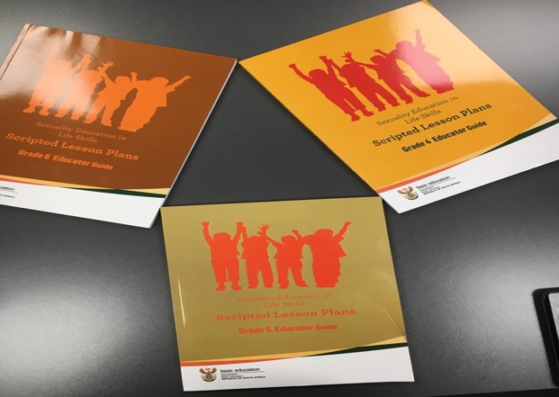
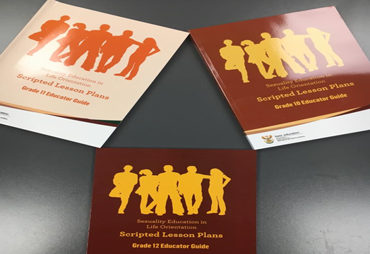
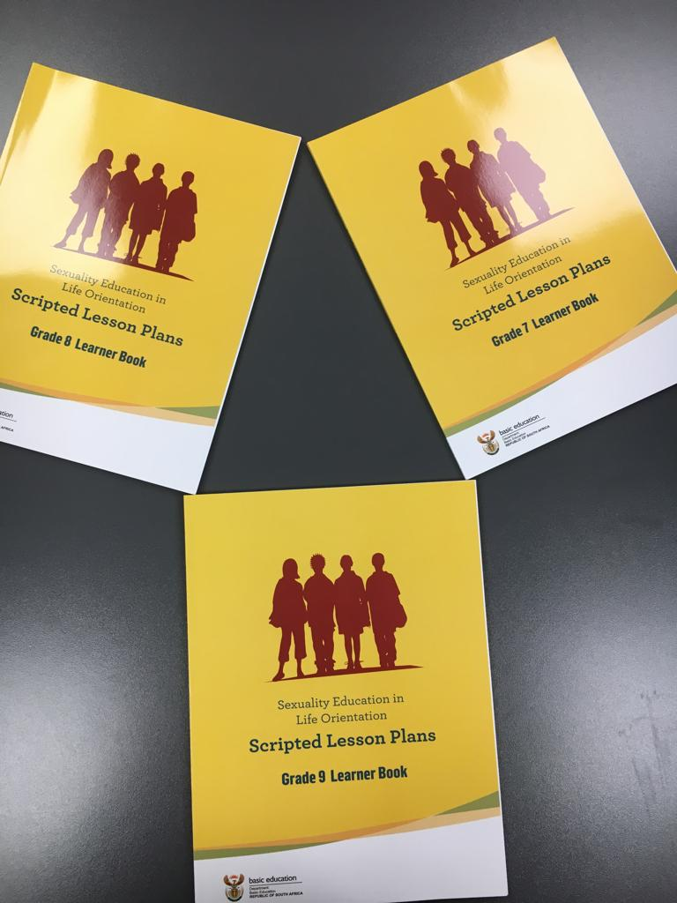
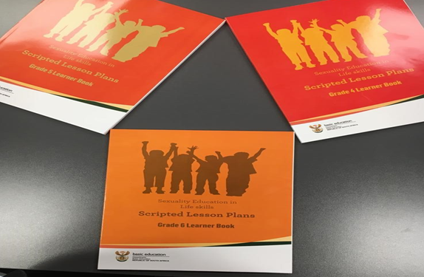
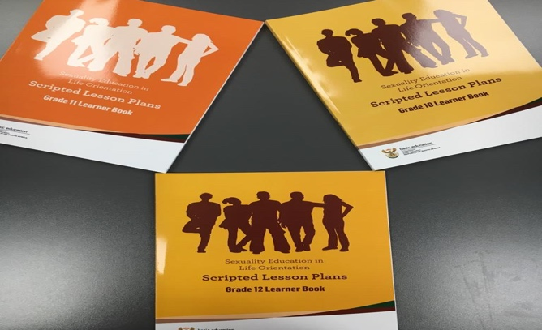
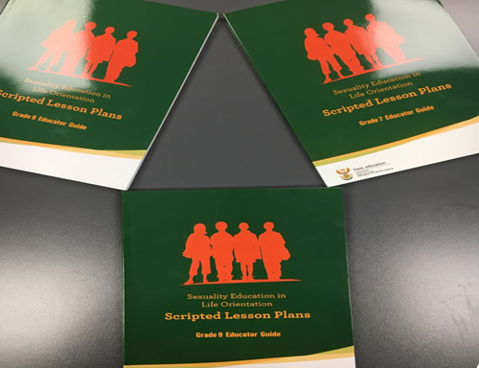
CSE SCRIPTED LESSON PLANS (SLPs)
Aligned with the Curriculum Assessment Policy Statements (CAPS) Age-appropriate and by Grade
Contextualised
Pre-tested and revised post-testing
12

Slide 12
Core Messages 4, 5, 6
I have the right to be protected, safe and loved. I can get help when I need it.
I make good choices for my health.
I care for you, I care for me. We care for each other.
I choose to respect my own body and the bodies of others.
I choose friends who are loyal and good for me.
I have the right to say “no” and the responsibility to respect a “no” to any unwanted touch or attention.
I think boys and girls should be valued equally.
I have a purpose in life and who I am matters

Slide 13
Core Messages 7, 8, 9
If you are having sex, get tested for HIV and other STIs regularly.
If you choose to have sex, use a condom every time.
The safest choice is not to have sex.
Stay faithful to one partner at a time to protect yourself, your partner and your community.
Both men and women are responsible for preventing pregnancy, HIV and other STIs.
You have the right to say “no” to sex in any situation.

Slide 14
CSE target group in Schools
Phase: Life Skills or Life Orientation | Grade | Age (a year older or younger) | SLP Focus | School: Primary/High
Intermediate (LS) | 4 | 10 years | Safety of learners empower them against abuse and bullying (basis for GBV later). Link learners to psycho social services (PSS). | Primary School
 | 5 | 11 years
 | 6 | 12 years
Senior (LO) | 7 | 13 years | Risk reduction, contraception and HIV prevention messages, prevent GBV and provides information to the learner to make the right choices. Link to health services.
 | 8 | 14 years |  | High School
 | 9 | 15 years
Further Education & Training (LO) | 10 | 16 years | Risk reduction messages, contraception and support the learner to finish matric and lead a productive adult life post high school. Link to health services.
 | 11 | 17 years
 | 12 | 18 years

Slide 15
CSE IMPLEMENTATION THROUGH CO-CURRICULUM
Adolescent Girls and Young Women Programmes (AGYW) Programme (Global Fund and USAID)
Since 2013, the DBE through funding from the Global Fund has been implementing the Keeping Girls in School programme.
A comprehensive package of services including health sessions, homework assistance, home visits, career guidance and peer education sessions including access to SRHS.
Breaking the silence
The DBE in partnership with the financial assistance from the Global Fund, produced a reality television show on Sexuality Education called Breaking the Silence.
Launch of the series is planned for November 2021 to be aired by SABC in January 2022
15

Slide 16
CSE IMPLEMENTATION THROUGH CO-CURRICULUM
Determined Resilient Empowered AIDS-free Mentored Safe (DREAMS)
Key findings on AGYW from the DREAMS evaluation study conducted in eThekwini and uMgungundlovu in KwaZulu-Natal and COJ and Ekurhuleni in Gauteng in 2018 include :
The HIV incidence in AGYW in the DREAMS evaluation is in keeping with the downwards trends found in other studies;
The HIV prevalence in AGYW in 12-24 years was 10.3% overall;
Two thirds of AGYW (67,7%) did not know their status, while 89,5% of those who knew their status were on ARVs, and 90,9% were virally suppressed; and
AGYW exposed to DREAMS program, adopted health seeking behaviour such as contraception and condom use, and increased HIV testing.
16

Slide 17
CSE IMPLEMENTATION THROUGH CO-CURRICULUM
Determined Resilient Empowered AIDS-free Mentored Safe (DREAMS) funded by the USAID
A comprehensive, multi-sectoral package of core interventions addressing key factors that make girls and young women particulary vulnerable to HIV.
LET’S TALK CAMPAIGN ON PREVENTION OF EARLY AND UNINTENDED PREGNANCY (EUP)-UNESCO
South Africa is one of the ESA Countries that has been included in the Let’s Talk Campaign on EUP which is a social behaviour change campaign aimed at increasing efforts in the region to address EUP among teenagers launched in 2019 by Minister of Basic Education.
Inter-generational dialogues on Let’s Talk EUP are in process.
17

Slide 18
Misconceptions about CSE
MYTHS | FACTS
CSE leads to early sexual initiation | CSE leads to later debut and more responsible sexual behaviour
CSE deprives children of their innocence | Evidence shows that children benefit from receiving appropriate information that is scientifically accurate, non-judgmental and age and developmentally appropriate
CSE goes against our culture or religion | CSE stresses the need to engage with the local contexts including engagements with traditional leaders, religious communities and local stakeholders. CSE addresses harmful social norms and negative practices that are not in line with human rights or that increase vulnerability and risk, especially for young women and girls

Slide 19
Misconception about CSE
MYTHS | FACTS
Teaching masturbation in Grade 4 | No masturbation topic in Grade 4 topics
Teaching of sexual pleasure in the curriculum | The focus of the SA curriculum is not on sexual pleasure but on prevention of HIV, STIs, early and unintended pregnancy, healthy lifestyle choices and avoidance of risky behaviours using a rights based approach
Teaching of UNESCO ITGSE | LO Curriculum is based on SA context. The ITGSE was adjusted to strengthen the content of the CAPS topics. There are no new topics.
It is the role of parents to educate children about sexuality | Parents play an important role in educating young people about sexuality. However, CSE complements this role by providing holistic education in a safe and supportive environment

Slide 20
Misconception about CSE
MYTHS | FACTS
The CSE is using pornographic imagery | Images used in the curriculum are based on protocols and standards set by the DBE that ensures protection of human dignity and rights and does not expose learners to offensive content
Teaching of types of sex in the curriculum | The CSE in the CAPS focuses on the total person and is teaching age-appropriate content that focuses on relationships, life skills, values and does not teach learners how to have any form of sex
CSE will be rolled out without teacher training and teachers are expected to teach new content they are not comfortable with | Since 2000, the Department has been providing in-service teacher training on Life Skills and Life Orientation. Training manuals on the Sexuality Education Scripted Lessons Plans has also been developed to build the capacity of LO educators to deliver the strengthened content

Slide 21
Findings on the provision of CSE
Curriculum-based sexuality education programs contribute to:
Delayed
sexual
debut
Decreased frequency of sexual intercourse
Decreased number of
sexual
partners
Reduced
risk
taking
Increased
use of
condoms
Increased
use of
contraception
–protection from early pregnancy

Slide 22
LESSONS LEARNT
Since the strengthening of CSE programmes, the following trends have been observed in the past 5 years:
Decline of HIV incidence among AGYW of 15-24 from 2000 to 1300 weekly;
Decline in learner pregnancies from 99 000 in 2013 to 86 000 in 2017; though 2020/2021 a marked increase due to Covid 19
Increase in uptake of HIV ART including AGYW;
Increased health seeking behaviours among AGYW exposed to CSE programmes; and
Improvement in the consistency of messaging across programmes.
18

Slide 23
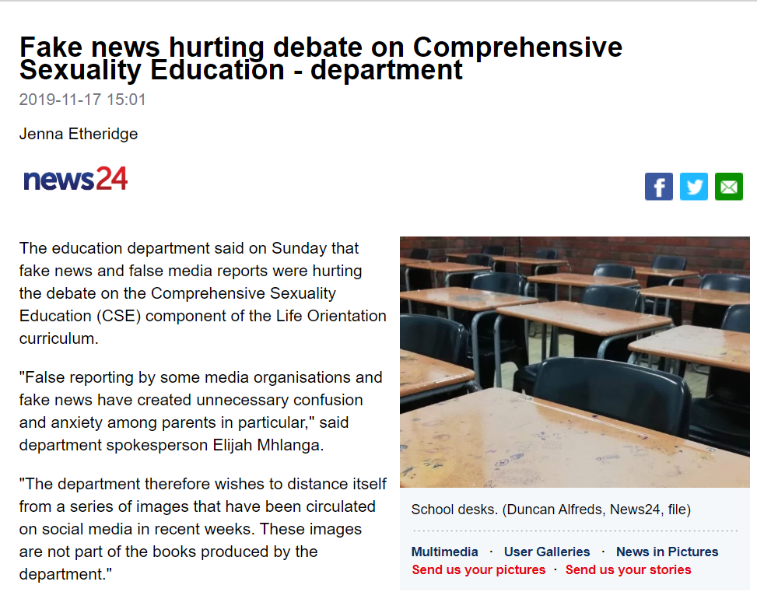
In Summary, the purpose of CSE is to empower learners so that they are able to:
Identify and report sexual abuse
Prevent HIV infections (those who were born with HIV to stay on treatment)
Prevent learner pregnancy
Prevent bullying and negative peer pressure
Know where to get help needed (rape victims, TB & ART, contraception, substance abuse)
Stay in school until they complete Grade 12.

Slide 24
Thank you

