Slide 1
The Impact of the COVID-19 Pandemic On Births and Population Trends in China
Cuiling Zhang
Ph.D./Researcher
China Population and Development Research Center

Slide 2
Agenda
The trends of number of births and fertility before the pandemic
The impact of COVID-19 on marriage and fertility intention and fertility plan before and after the outbreak
The changes of newborn population in 2020-2021
relative annual and monthly changes of births
parity, regional and age group differential
The prospects of future fertility in China and suggestions

Slide 3
Part1
The trends of number of births and fertility before the epidemic

Slide 4
China has long been plagued by its low fertility before the outbreak
China's newborn population increased in 2016 as two child policy effect, and then embarked on a downward trend, with a historic low birth record in 2020 by 12.0 million.
TFR followed the same downward trend and reach a record low at 1.3.

Slide 5
Rapid and effective epidemic control in China
The number of confirmed cases and deaths is far less than other countries
Note: statistics until December 3, 2021;
source: the website of WHO and National Health Commission of China.
 | Cumulative confirmed cases | Number of deaths
China | 128,245 | 5,697
Global | 263,563,622 | 5,232,562
2. Less psychological fears and social anxiety caused by COVID-19
among childbearing age groups in China
China has quickly and effectively contained the outbreak, with infections being mainly concentrated in few areas.
3. Significantly lower Unemployment rate than other developed countries.
China has instituted various policy measures to ensure stability in 6 key areas and to meet 6 priorities, especially for employment and livelihood.

Slide 6
The influence of COVID-19 on marriage and childbearing(1)
1. Marriage further delayed and much less people get into marriage in 2020 than previous year.
Annual marriage registration
9.27 million in 2019
8.13 million In 2020
Relative change in the pairs of marriage registration compared with the previous year (%)
Marriage registration in the first three quarters
7.13 million 2019
5.89 million in 2020
5.87 million of 2021,
A decline by17.5% compared with 2019

Slide 7
The influence of COVID-19 on marriage and childbearing(2)
2. The proportion of delaying /abandoning the pre-pandemic fertility plan relatively high.
According to the survey of Hubei Federation of Worker Union:
53% respondents has changed their fertility plan.
young people, urban residents, couples with 1-child are more likely to change .
people in relative advanced reproductive age and people who planned to have a second children are more likely to abandon family planning because of COVID-19.
The National Population and Family Dynamic Monitoring Panel Survey in 2021 shows :
Among those who have further fertility plans before pandemic, 32.6% are affected.
74.6% postponed fertility plan;
16.8%’s fertility plans are abandoned.

Slide 8
The influence of COVID-19 on marriage and childbearing(3)
3. The top 3 reasons for people postpone pre-pandemic fertility plan:
56.7%:
worry about the protentional impact of vaccination on the fetus ,
52.2%:
anxious about the difficulty of maternal and natal health services utilization during pandemic,
50.3%:
fear about the instability of income and family income.
(Source: the National Population and Family Dynamic Monitoring Panel Survey in 2021, NHC, China

Slide 9
Part3
The changes of newborn population in 2020 and 2021
(annual ,monthly changes and parity, age differential)

Slide 10
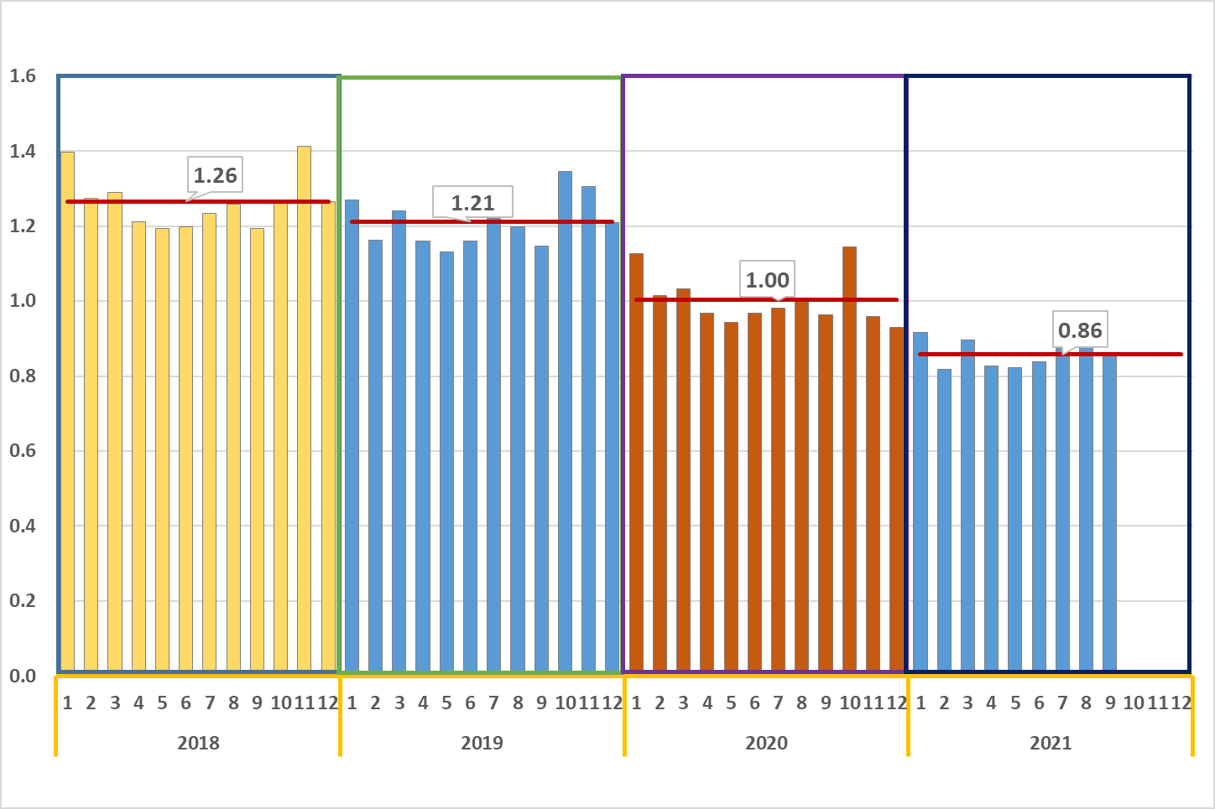
The annual birth of China declined much fasten in 2020.
The annual monthly births in 2019-2021 (in Million)
Source: calculation based on data from National Bureau of Statistics and National Health Commission of China.

Slide 11
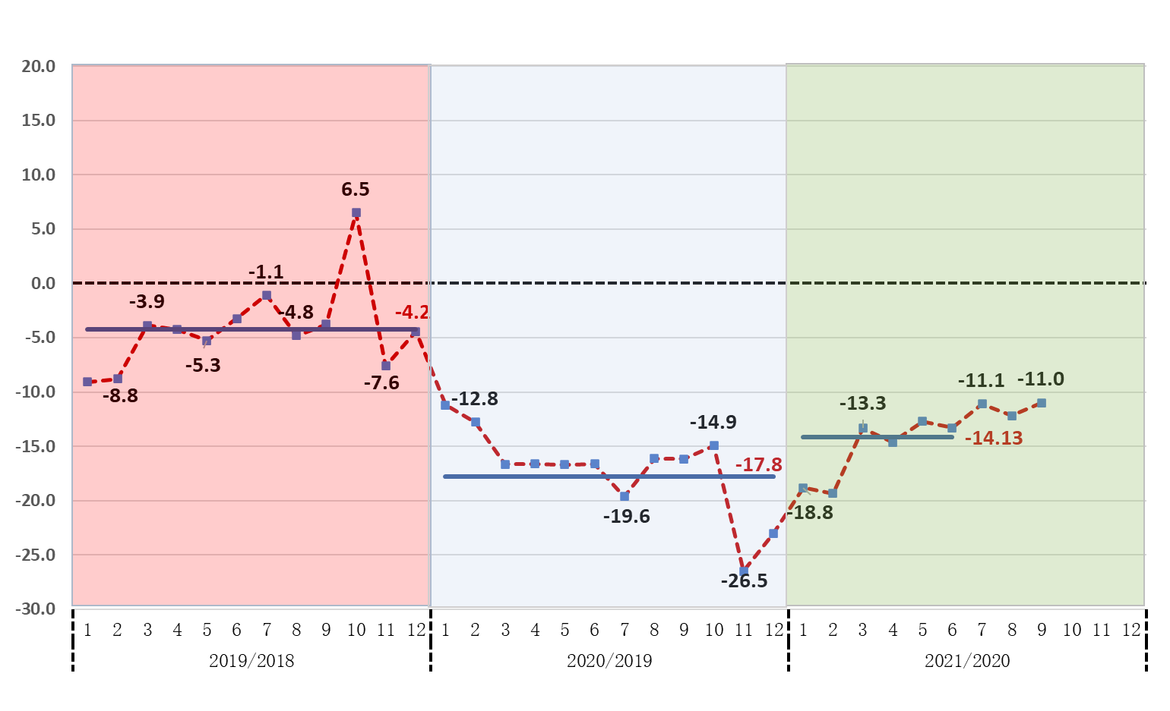
The monthly births declined sharply in Nov. and Dec. 2020, followed by gradually recovery in 2021. compared with same month in previous year
The annual monthly births in 2019-2021 (%)
Source: calculation based on data from National Health Commission of China.

Slide 12
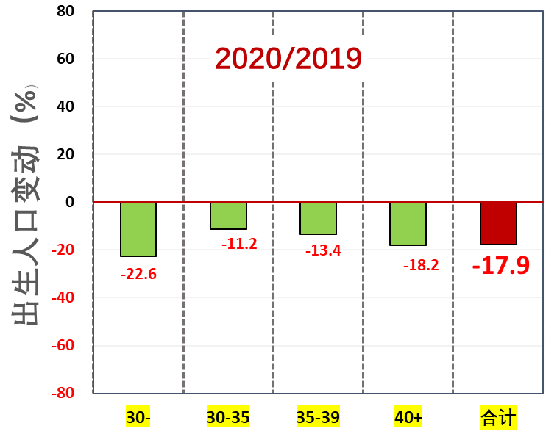
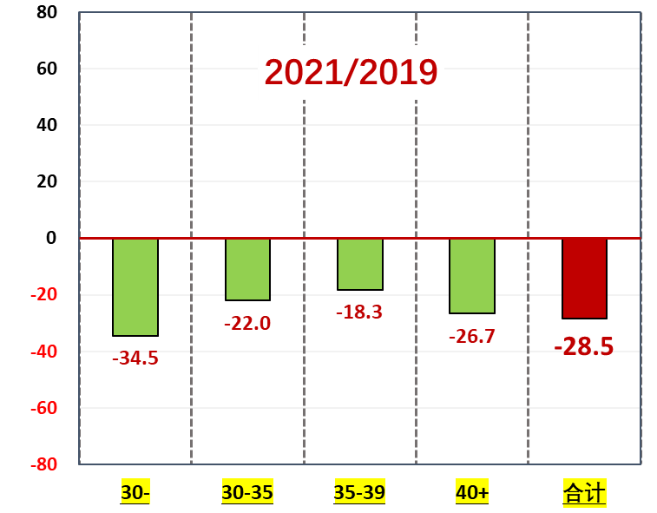
The birth decline of people aged below 30 is the key driver of newborn population shrinkage in recent years.
The relative annual birth changes by age group in China, 2020-2021 compared with that of the year of 2019
Total
Total
Source: aalculation based on data from National Health Commission of China.

Slide 13
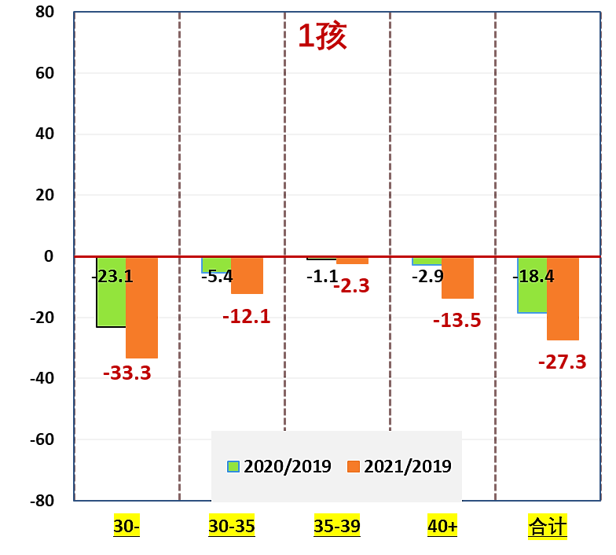
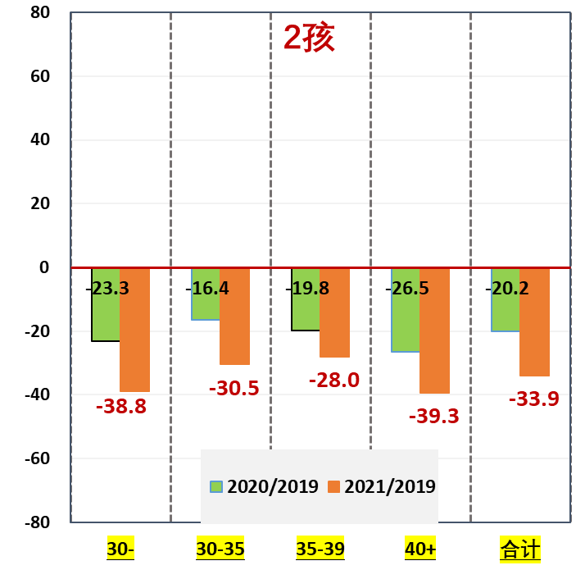
The number of 1st birth endured a continuous decline in 2020 with a further drop in 2021. especially for women under age 30,
The relative annual birth changes by age group and by parity in China, 2020-2021 compared with that of the year of 2019
1st birth
2nd birth
Total
Total
The number of 2nd birth decline in 2020 and 2021 for all age group.
Source: calculation based on data from National Health Commission of China.

Slide 14
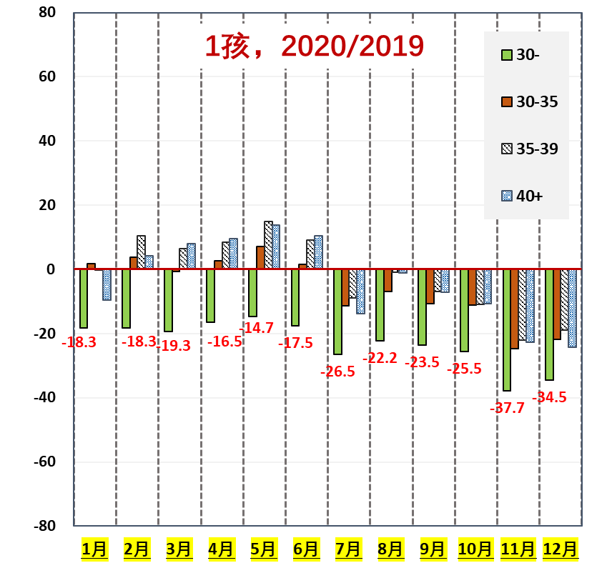
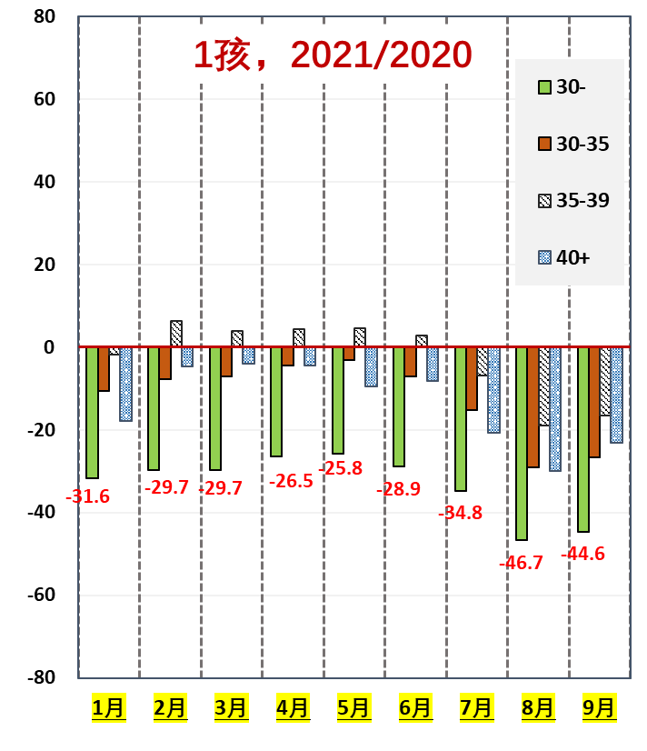
The number of 1st birth for women under age 30 endured a continuous decline in all the months in 2020 , especially in Nov. and Dec, then followed with a further drop in 2021.
The relative monthly 1st birth changes by age group in China, 2020-2021 compared with that of the year of 2019
1st birth 2020/2019
1st birth 2021/2019
Source: calculation based on data from National Health Commission of China.

Slide 15
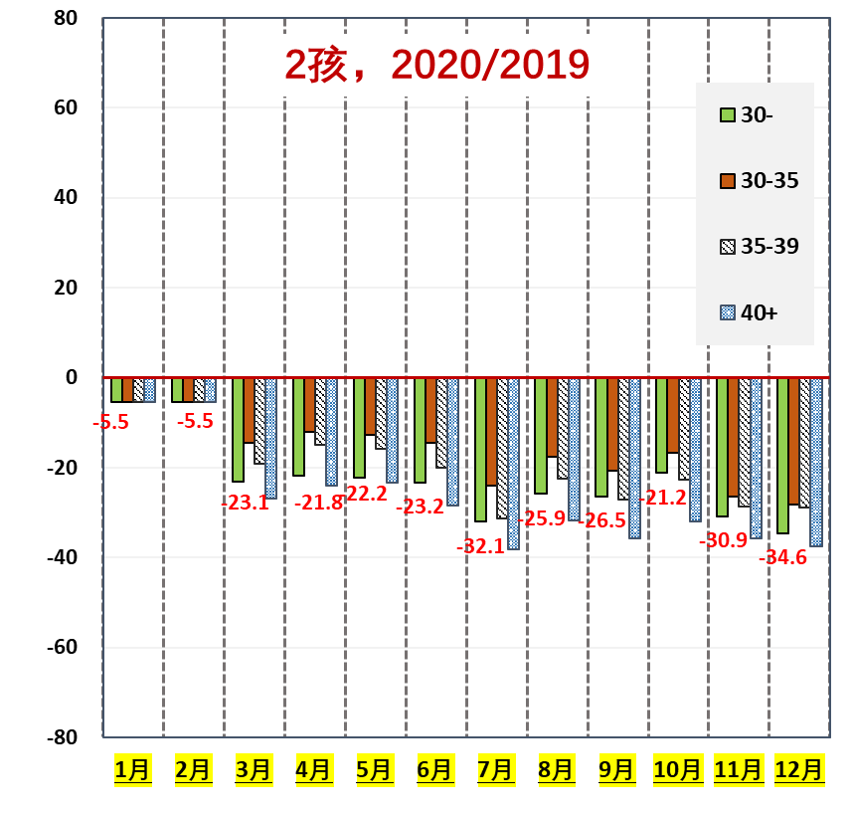
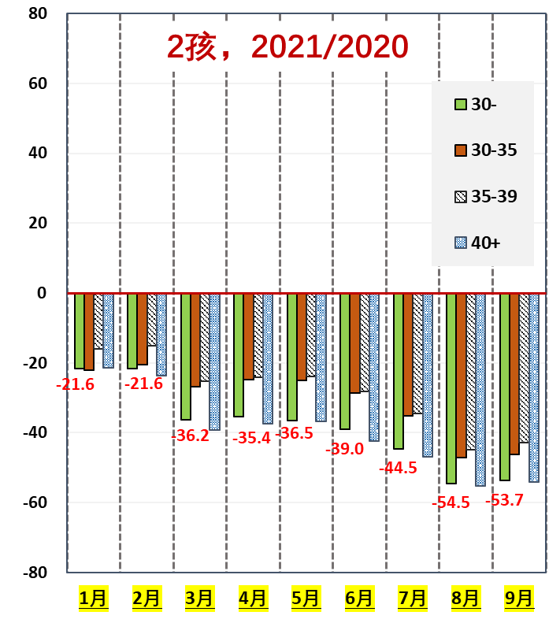
The monthly 2nd birth declined in all age groups and in all the months in 2020 , with a relative higher degree of decline in end of the year. In 2021, it continued the downward trend for all age groups and all the months, reflecting that people with a second child plan are more likely to postpone after the pandemic.
The relative monthly 2nd birth changes by age group in China, 2020-2021 compared with that of the year of 2019
2nd birth 2020/2019
2nd birth 2021/2019
Source: calculation based on data from National Health Commission of China.

Slide 16
The regional monthly crude birth rate universally declined after the pandemic
Pre-pandemic:
Jan-Sept.2020
Post-pandemic:
Oct.2020-Aug.2021。
Source：NHC,China; The 2020 census

Slide 17
Key findings(1)
1. The decrease of people in reproductive age is the defining factor of birth shrinkage in recent years.
2. The outbreak of COVID-19 further depressed the number of newborn population and fertility of China in 2020 and 2021
Much less childbearing for people under 30 in past 2 years;
The number of 1st birth endured a drastic decline, with a much sharper decline for the young;
Much less births occurred in November & December in 2020.
The number of 2nd birth dropped in 2020 -2021 due to 2nd birth postponement after pandemic;
The monthly CBR went down in most of the provincial level, with an average at 13.7%.

Slide 18
Key findings(2)
3. The birth in near future is still likely to be affected by vaccinating and marriage postponement
The potential childbearing for 1st birth are highly affected by the marriage decline in past 2 years;
The people vaccinated have to postpone childbearing plans;
4. Both national and local government of China are taking supportive measure s to help family to alleviate the negative impact of the epidemic on marriage and childbirth.
Strong determination to promote the Realization of Moderate Fertility
has been included in the national 14th Five-year Plan and the outlined long-term goals
More social and family support policy has been stipulated
Childcare system under construction to support parent to balance work and family

Slide 19
The impact of COVID-19 on China’s birth and population trends requires strengthened monitoring and dynamic evaluation
Many uncertainties with enduring COVID-19
2. Conduct survey to explore the changes of fertility intention and childbearing behavior before and after the pandemic
Identify the obstacles restricting the realization of fertility will after the outbreak of the epidemic and facilitate the realization of people’s fertility intention through targeted measures.
Timely demographic data collection and strengthen monitoring and dynamic evaluation
Strengthen the analysis and application of vital statistics , including birth, death and marriage registration to understand the short-term fluctuations of birth and population trend after COVID-19 outbreak.
Make full use of monthly birth registration ;
In-depth mining live birth data, vaccination data and pregnancy registration data

Slide 20
Thank you! ➔ also to the research group at the CPDRC!
Dr. Xuying Zhang
Dr. Yue Li
Dr. Danyin Wang
Dr. Ying’an Wang
Contact: Cuiling Zhang (zcl_cpdrc@126.com)

