Slide 1
NPO ACT AMENDMENTS BY
The General Laws (Anti-Money Laundering and Combating Terrorism Financing) Amendment Act, Act No. 22 of 2022

Slide 2
PURPOSE
To present NPO Act amendments introduced by the General Laws (Anti-Money Laundering and Combating Terrorism Financing) Amendment Act, 2022;
To present how NPOs and officials dealing with NPOs are impacted by the changes;
Present on Money Laundering and terrorist financing abuse on NPOs and how NPOs can protect themselves.

Slide 3
Presentation Outline
Towards compliance with recommendation 8
Summary of amendments introduced by the GLAA in the NPO ACT
Sections amended and how NPOs are impacted
Money Laundering an Terrorist Financing
Modalities of NPO abuse by terrorist organizations
Indicators for identification of suspicious activities related to terrorism financing
How NPOs can protect themselves against ML/TF
Resources for screening of office-bearers
Way forward
Conclusion

Slide 4
CONTEXTUAL BACKGROUND
The Financial Action Task Force (FATF) is an international-governmental body established in 1989. After the September 11 terror attacks, the FATF’s mandate was expanded to include terrorism financing
FATF has developed the 40 Recommendations which ensure a coordinated global response for combating money laundering, terrorist financing and other related threats to the integrity of the international financial system.
FATF evaluate these standards on the effective implementation of
(i) legal,
(ii) regulatory and
(iii) operational measures that aim to prevent these illegal activities and the harm they cause to society
DSD as NPO Regulator is expected to comply with Recommendation 8 – ensure that SA has adequate measures and systems that prevent abuse of NPOs for ML/TF knowingly and unknowingly.
The FATF conducts periodic reviews with member countries to ensure that they implement the FATF Standards fully and effectively.
Terrorist constantly adapt how and where they move funds and other assets to circumvent safeguards that countries have put in place.

Slide 5
Inter-Departmental Multi-Agency AML/CTF/CPF Approach
Relevant Government Clusters and Policy Departments
Justice, Crime Prevention and Security:
ACTT, NICOC SSA, SAPS, DHA, J&CD, CS
Economic Sectors, Employment & Infrastructure Development: AFF, ED, DMR, EA, Energy, PE, NT, S&T, SBD, PW, Transport, Presidency (DPME)
International Cooperation, Trade and Security: NT, DIRCO, DTI, Tourism, SSA, Environmental Affairs
Governance and Administration: J&CS, DPSA, DHA, NT, the Presidency (DPME)
Operational Departments
FIC (L&P, CAP, MAA)
SARS (Investigations, Customs)
SAPS (DPCI, CI Detectives)
NPA (SCCU, PCLU, AFU, SIU)
Financial Sector and Non-Financial Designated Businesses and Professions (DNFBP) Supervisory Bodies (SARB, PA & FSCA)
IPID
IDWGs/Task Teams: UNSC, CTIDWG, Beneficial Ownership, ACTT, IFFs,
CIPC & NPC
Master of the High Court
SSA & NICOC
DSD (Non-Profit Directorate)
DEA
Private Sector: Banks, Attorneys, Real Estate Agents, Retail Sector ,etc.
Civil Society Legal Arrangements
Companies Legal Persons
Businesses & Professions
Financial Institutions Financial Service Providers

Slide 6
COMBATING THE ABUSE OF NON-PROFIT ORGANISATIONS (RECOMMENDATION 8)
NPOs may be vulnerable to being misused for other offenses such as ML, tax crimes, and other predicate offenses, as any other type of legal person or legal entity, R.8 is focused exclusively on TF.
Recommendation 8 does not apply to the NPO sector as a whole.
Its important for countries to take a targeted approach to implementing the measures in Recommendation 8 which include oversight and regulatory mechanisms, based on an understanding of the diversity of the NPO sector and the terrorism risks faced by the NPO sector.
Total Population of NPOs in SA
NPOs at risk of TF
High risk NPOs

Slide 7
Mutual Evaluation Report
Recommendation 8
Combating the abuse of NPOs
SA rated non-compliant
SA has not done an assessment of their broader NPO sector to identify those organizations, based on their activities or characteristics , are most at risk of TF abuse.
SA also has no capacity to monitor or investigate NPOs identified to be at risk of TF abuse.
The government authority responsible for oversight of the NPO sector has not had any TF training nor have they applied any measures to address the risk to NPOs of TF abuse nor begun monitoring of organizations deemed to be vulnerable
Immediate Outcome 10
Terrorists and terrorist financiers are prevented from raising, moving and using funds, and from abusing the NPO sector. SA rated as low level of effectiveness
SA NPOs laws and regulations review are not adequate to identify, prevent and combat acts of ML/TF within the sector
South Africa has not identified the subset of NPOs that, based on their characteristics or activities, are at risk of TF abuse.

Slide 8
Development of GLAA
National Treasury led the process of amending legislations that were not responsive to measures and standards set by FATF in combating ML/TF
This done through the General Laws Amendment Act to ensure compliance with FATF standards for combating ML/TF.
Series of consultations to gather inputs were held with various stakeholders towards development of the GLAA.
NPO Act of 1997 was amended on 21 December 2022.
Trust Property Control Act, 1988,
Financial Intelligence Act, 2001
Non Profit Organisations
Act, 1997
Companies Act, 2008

Slide 9
Grey listing Rating
In January 2023, SA was re-assessed to establish the extent through which the country has managed to address identified weaknesses as contained in the Mutual Evaluation Report.
FATF acknowledged progress made by SA in addressing identified weaknesses however SA was given a grey listing rating in February 2023.
The finding was that SA was not fully compliant with international standards around the prevention of money laundering and terrorist financing.
The implication for grey listing is that sustained monitoring of the sector is required to ensure compliance with FATF standards and to demonstrate sustainable progress in prevention and combating ML/TF.
Prolonged grey listing has economic implications – subject to high interest rates & serious scrutiny internationally.

Slide 10
TOWARDS COMPLIANCE WITH RECOMMENDATION 8
According to recommendation 8, countries must implement a risk-based approach and proportional measures to protect the NPOs identified as being vulnerable to ML/TF by FATF.
To comply with this requirement the NPO Directorate is:
In a process of formulating NPO policy to promote accountability, integrity, and public confidence in the administration and management of NPOs.
Implementing the changes made by GLAA to the NPO Act.
undertaking outreach and educational programmes to raise and deepen awareness among NPOs as well as the donor community about the potential vulnerabilities of NPOs to ML/TF.
Taking part in the process underway for the National Risk Assessment to identify the subset of NPOs most at risk of ML/TF.
The obligations under Recommendation 8

Slide 11
Sections within the NPO Act that have been amendments & how they impact on NPOs

Slide 12
SUMMARY OF AMENDMENTS INTRODUCED BY THE GLAA IN THE NPO ACT
PRESCRIBED REQUIREMENTS FOR (NPOS)
Compulsory registration of specified non-profit organisations (NPOs);
Requirements for registered NPOs to submit the following prescribed information:
Information about the office-bearers, control structure, governance, management, administration and operations of NPOs;
Requirements for timely submission of changes to the organisation’s information to the NPO Directorate and for the information to be included in the register that the Director must keep and provide access to that information.
Reporting of office-bearers who have been convicted whilst serving in the board, not complying with certain obligations or are disqualified due to a court order.
PRESCRIBED REQUIREMENTS FOR THE NPO DIRECTORATE
Keep and Maintain a register containing all prescribed information on registered NPOs and provide public access thereof;
Keep and maintain a register of disqualified office-bearers and make it publicly available in line with POPIA;
Collaborate and enter into agreements with other organs of state in performing the Directorate’s functions;
Provide for certain contraventions of the NPO Act.
Disqualification of a person to be appointed or continuing to act as an office-bearer of a registered NPO and the grounds for removal of an office-bearer by the NPO Director; and

Slide 13
(SEC. 12.1 (b)) COMPULSORY REGISTRATION OF SPECIFIED NON-PROFIT ORGANISATIONS
Registration under the NPO Act is mandatory if an NPO is operating and offering the following services outside the boarders of the boarders of the Republic:
making grants to individuals or organisations outside the boarders of the republic.
Providing humanitarian, charitable, religious, educational or cultural services outside the boarders of the republic.
CONT……

Slide 14
HOW NPOS ARE IMPACTED BY THE CHANGES
Prescribed information for compulsory registration
If an organisation is falling under the compulsory registration category, the following prescribed information must be submitted:
In respect of Office-bearers
NPOs must submit:
Names & surnames;
ID/Passport and date of birth in case of a non-South African citizen;
Portfolio of position;
physical & postal address; and
contact details.
In respect of Control Structure
NPOs must submit:
Legal form of entity;
Income tax number;
Type of control structure (ie Executive committee, Council, Board of Trustees etc);
Affiliate organisations if any;
Fiscal sponsorships if any; and
Details of founder member/s & patrons who direct the NPO.
In respect of administration and operations
NPOs must submit:
Business address;
Contact details;
Registered address if applicable;
Trading name if different from the name under which it is incorporate;
Services offered; and
Countries where services are offered.
CONT……

Slide 15
HOW NPOS ARE IMPACTED BY THE CHANGES
Requirements for registration
Organisations who’s registration is compulsory must:
Ensure registration before the end of 31 May 2024 as indicated in the Gazette published in May 23.
Submit the required prescribed information to the NPO Directorate including details of people who own and direct activities of the NPO.
NOTE: Organisations falling under this category and are already registered must complete the required information during submission of reports. The new narrative report form with prescribed information can be obtained from the NPO Directorate.
Organisations who are not registered in terms of the NPO Act must register by completing the prescribed application form for compulsory registration which is also obtainable from the NPO Directorate.
CONT……

Slide 16
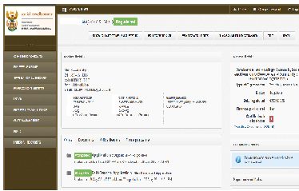
(SEC. 24) ACCESS TO INFORMATION
Prescribed information in respect of office-bearers, administration and operations, and control structure of all registered NPOs will be kept in a register that the NPO Director must make publicly available in the following manner:
At the office of the Director of NPOs between the hours of 08:30 and 12:00, and 13:30 and 15:30, from Monday to Friday.
The director may also provide electronic access to the information in the register
Access to the information may be requested in accordance with the Promotion of Access to Information Act, 2000 (Act No. 2 of 2000).
Information relating to the identity of the person(s) who own, control or direct the activities of high risk NPOs, including senior officers, board members and trustees, should be made publicly available.

Slide 17
HOW NPOS ARE IMPACTED BY THE CHANGES
Registered NPOs must ensure that:
Accurate and up to date information in respect of office-bearers, administration and operations of the NPO, and control structure is provided to the NPO Directorate.
Changes to the organisation’s information must be provided to the NPO Directorate as soon as the changes have been made.
Information on all registered NPO will be made publicly available on request.

Slide 18
(SEC. 25A) PROCESS OF DISQUALIFICATION OF OFFICE-BEARERS (Cont..)
Instances of disqualification
An office-bearer can be disqualified if he/she:
is an un-rehabilitated insolvent;
has been prohibited by a court to be a director of a company, or has been declared by a court to be delinquent;
has been removed from office on the grounds of misconduct involving dishonesty;
is an un-emancipated minor, or is under a similar legal disability;
Is listed under the United Nations Security Council list for financial sanctions of individuals involved in financial crimes;
Has a criminal record involving:
theft, fraud, forgery, perjury fraud, misrepresentation or dishonesty, money laundering or terrorist financing.

Slide 19
(SEC. 25A) PROCESS OF DISQUALIFICATION OF OFFICE-BEARERS
Process of disqualification
The Registrar of the Court—
must, upon the issue of an order for the removal of an office-bearer on the grounds of misconduct involving dishonesty; or
a conviction for an offence send a copy of the relevant order or particulars of the conviction, as the case may be, to the NPO Directorate.
The Directorate —
must notify the NPO about the order or conviction and to whom the order or conviction relates.

Slide 20
HOW NPOS ARE IMPACTED BY THE CHANGES
NPOs must:
Exercise due diligence when electing office-bearers by conducting background checks before election into office.
Check members against the CIPC list of delinquent directors.
Check if members are not listed under the United Nations Security Council list for financial sanctions of individuals involved in financial crimes.
Check if members are not listed as offenders or have criminal record etc.

Slide 21
(SEC. 25A(9)) REGISTER OF DISQUALIFIED OFFICE-BEARERS AND DISQUALIFICATION PROCESS
The NPO Directorate must establish, maintain and provide access to a register of persons disqualified from serving as office-bearers in terms of:
an order of a court or
a notice of disqualification by the NPO Director.
REGISTER OF DISQUALIFIED OFFICE-BEARERS
(a) Full forenames and surname;
(b) Thirteen digit identity number in the case of a South African, or passport number and date of birth in the case of a foreign national;
(c) Case number of the court proceedings pursuant to which the person became disqualified;
(d) Date on which the court order resulting in disqualification takes effect;
(e) Date on which the disqualification expires; and
(f) reason for disqualification.
The Directorate must allow any person to inspect the register referred to, at the office of the Director of NPOs between the hours of 08:30 and 12:00, and 13:30 and 15:30, from Monday to Friday.

Slide 22
HOW NPOS ARE IMPACTED BY THE CHANGES
NPOs:
Should a board member be disqualified through a court order whilst serving as an office-bearer, the organisation must submit the court order to the NPO Directorate within 30 days after a court order is granted.
Apply own constitutional material provisions on office-bearers who are charged with misconduct or dishonesty, failing which they may be reported to the NPO Director who has the powers to disqualify the office-bearer if found guilty.

Slide 23
ADMINISTRATIVE SANCTIONS
Requirement of Section 29
The director may impose an administrative sanction if the NPO has failed to –
perform any duty imposed by, or has failed to comply with the requirements to submit prescribed information in terms of the NPO Act.
register as required in terms of section 12(1)(b) of the Act, within the period determined by the Minister by notice in the Gazette
CONT……

Slide 24
HOW NPOS ARE IMPACTED BY THE CHANGES
Administrative Sanctions that may be imposed on NPOs
The director may impose any one or more of the following administrative sanctions:
a caution;
a reprimand;
a directive to take remedial action or to make specific arrangements; or
the restriction or suspension of certain specified activities of the NPO.

Slide 25
Money laundering & terrorist financing risks on NPO’s

Slide 26
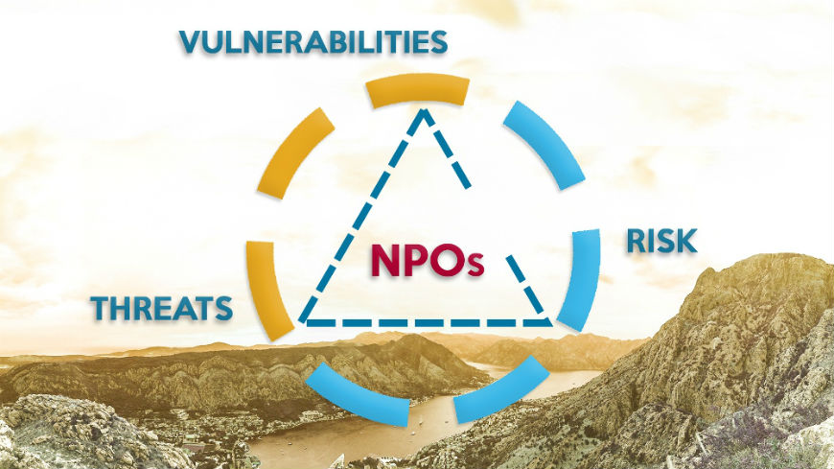
MONEY LAUNDERING & TERRORIST FINANCING RISKS ON NPOS
NPOs may face numerous risks related to money laundering (ML), fraud, corruption, tax evasion, among others.
It is important to note that an NPO may be abused by donors, partner organisations or the NPO’s fund beneficiaries.
It is therefore important for NPOs to conduct an internal analysis that examines threads and risks that would render the organisation vulnerable to abuses of money laundering, fraud, corruption, tax evasion and to terrorists.

Slide 27
What is money laundering?
The word “Laundry” literally means “Cleaning”
Money Laundering refers to cleaning money

Slide 28
Defining money laundering
Money laundering is a criminal act of legitimizing money acquired through illegal or unethical means by disguising the origin of the crime. It usually involves the creation of assets to conceal the relationship between the funds and their dirty sources.
Money laundering is used as a means to obtain funding for terrorist financing.

Slide 29
How is money Laundered?
The donor who is the source tries to distance themselves from the money by requesting:
- A transfer of money to unknown beneficiary X. - False recording of services rendered by Y.
Money re-entering the system through clean investments, ie Purchasing of luxury assets
An unsuspecting NPO is granted dirty money to be place in the bank.
STEP:1
PLACEMENT
STEP:2
LAYERING
STEP:3
INTEGRATION
Illegal cash obtained through elicit crimes.

Slide 30
What is TERRORIST FINANCING?
Terrorist financing is the means by which terrorist obtain funds to finance their operations. It is the raising, moving, storing and using of financial resources for the purposes of terrorism.

Slide 31
How is Terrorist Financing achieved?
STEP: 1
RAISE FUNDS
STEP: 2
STRORE
STEP: 3
MOVE
STEP: 4
USE
Illegally:
Extortion;
Kidnapping;
Drugs;
Smuggling;
Fraud;
Theft.
Legally:
Donation;
Private sponsorships;
Controlled companies.
Bank accounts;
Prepaid cards;
Crypto currency
To terrorist networks;
Intra-bank accounts
Wire transfers
Crypto currency
Purchase weapons;
Recruiting & training terrorist,
Propaganda campaigns

Slide 32
How NPO’s can be abused by terrorist organizations

Slide 33
Modalities of NPO abuse by terrorist organizations
Diversion of the organisation’s funds
Affiliation with a terrorist entity
Abuse of the organisation’s programming
Support for terrorist recruitment
False representation
The goal of terrorists is to infiltrate a legitimate NPO, take over a certain level of control and gain influence in order to abuse its reputation and assets for their own benefit. They do this by using the following modalities identified by FATF:

Slide 34
1. Diversion of the organisation’s funds
One of the ways in which terrorist organizations can abuse an NPO is the diversion of funds raised by the association for implementation of their programs.
Diversion of funds may take place at different stages:
When donations are collected,
When funds are retained in the organisation’s itself, or
When they are being transferred to a legitimate beneficiary.

Slide 35
2. Affiliation with a terrorist entity
An NPO or an individual working for it, can maintain links with a terrorist organization or terrorism supporter.
The NPO’s resources could be used for propaganda purposes and promotion of extremist and terrorist ideologies or recruitment.
A “sham” NPO (or its branch) may be set up to implement terrorist objectives under the guise of humanitarian or educational activities to spread propaganda.

Slide 36
3. Abuse of NPO’s programming
The NPO can establish an educational centre and employ (or take in as volunteers) teachers to provide education and promote religious and cultural values. Only to find that teacher uses his/her position to indoctrinate young people and recruit them to a terrorist organization.
A volunteer who hands out the organisation’s advertising material, but at the same time distributes terrorist promotional materials.

Slide 37
4. Support for terrorist recruitment
A sham NPO may be established as an educational institution with the intent of exploiting kids for recruitment purposes.
Family members of an individual who is being coerced to join a terrorist organization or to commit a terrorist act, can also be considered a form of recruitment.

Slide 38
5. False representation
Terrorist may abuse the good reputation of an NPO by falsely claiming to be acting on behalf of the organisations to collect funds for the purposes of their programs, only to transfer funds to terrorist organizations, or use them to support terrorism.

Slide 39
Indicators for identification of suspicious activities related to terrorism financing

Slide 40
NOTE:
When assessing indicators for suspicious activities related to terrorism financing, it is important to note that:
The presence of certain indicators does not necessary mean that terrorism is taking place, there may be other possible alternative explanations which must also be taken into account.
terrorist Indicators may therefore be viewed as leads that require further investigation to assess the nature or risk of abuse.
CONT……

Slide 41
Indicators for identification of suspicious activities related to terrorism financing
FATF released a comprehensive list of indicators related to the risks of abuse of the NPO sector by terrorists. Indicators are divided into seven categories:
1. Financial support to known or suspected terrorists entities
2. Material support to known or suspected terrorists entities
3. Financial, material or logistical support to proscribed terrorist entities
4. Operations in areas where there are active terrorist threats
5. General operations and governance
6. Support to recruitment
7. Other criminal activities
CONT……

Slide 42
Financial support to known or suspected terrorists entities
Indicator | Terrorist Abuse Indicator
Use of cash couriers to transfer NPO funds into areas with known terrorist activity. | Resources of an NPO are transferred to an entity known to be engaged in, or supporting terrorist activity.
NPO transactions are structured to avoid transaction reporting.
Bank accounts related to some programmes or activities are concealed. | NPO receives resources from an entity believed to support or be engaged in terrorist activities.
NPO funds are transferred to entities not associated with declared programmes or activities.

Slide 43
2. Material support to known or suspected terrorists entities
Indicator | Terrorist Abuse Indicator
NPO facilities are frequented by individuals believed to support terrorist activities. | Resources of an NPO are transferred to an entity known to be engaged in, or supporting, terrorist activity.
 | NPO receives resources from an entity believed to support or be engaged in terrorist activities.
NPO assets, equipment or property is used for dual purposes. | NPO shares property with another organisation believed to support terrorist activity.

Slide 44
3. Financial, material or logistical support to proscribed terrorist
Indicator | Terrorist Abuse Indicator
NPO activities are found to support individuals or organisations whose identities correspond to those of listed entities (sanction list). | The identities of proscribed terrorist entities are found to match the identities of NPO directing officials or employees.
4. Operations in areas where there are active terrorist threats
Indicator | Terrorist Abuse Indicator
Entities operating in areas with known terrorist activity transfer funds into the bank accounts of an NPO, directing officials, or employees.
CONT……

Slide 45
5. General operations and governance
Indicator | Terrorist Abuse Indicator
NPO expenditures are not consistent with its programmes and activities. | Officials of an NPO are involved in the administration of other organisations believed to support terrorist activity.
NPO is unable to account for the final use of all of its resources.
NPO is unable to account for the origin of its income. | NPO receives resources that: Are not properly recorded or counted for, from an entity believed to support terrorist activities .
NPO has inconsistencies in its accounting and/or mandatory reporting.
NPO has opaque leadership or decision making structures. | NPO suffers from an internal conflict, where one faction is known to be sympathetic or actively supportive towards terrorist entities.
NPO or NPO representatives use falsified or conflicting documentation.

Slide 46
6. Support to recruitment
Indicator | Terrorist Abuse Indicator
NPO publications or those who represent the organisations support terrorism or terrorist entities. | Officials or employees of an NPO engage in activities that support recruitment to violence.
Individuals known to support terrorism are linked to the organisations.
7. Other criminal activities
Indicator | Terrorist Abuse Indicator
NPO facilities conceal criminal activities. | Criminal activities consistent with terrorist operations are concealed in NPO facilities.
NPO directing officials or employees are engaged in other criminal activities
Advertised NPO is fictitious. | NPO directing officials or employees are engaged in other criminal activities consistent with terrorist operations.
CONT……

Slide 47
What NPO’s can do to protect themselves against money laundering & terrorist financing risks

Slide 48
WHAT CAN NPO’S DO TO PROTECT THEMSELVES AGAINST MONEY LAUNDERING & TERRORIST FINANCING RISKS
KNOW YOUR RISKS
“Be Aware - Be Safe”
AWARE
SAFE
Attentive: Screen partners & associates.
Watchful: Be vigilant, ask questions.
Act: Find proof, evaluate the situation & take action.
Report: suspicious findings
Educate: members and staff on ML/TF risks.
Attentive
Watchful
Act
Report
Educate
Screen
Ask
Find
Evaluate

Slide 49
HOW NPOS CAN PROTECT THEMSELVES AGAINST ML/TF (Cont..)
Ensure proper governance procedure in:
Upholding organisational integrity – establish strong financial and human resource policies
Financial accountability and transparency – keep proper financial records of income and expenditure and mandate that all organisation's transaction be conducted by means of a bank account.
Programme planning and monitoring – establish appropriate internal controls and monitoring systems to ensure that funds and services are being used as intended.

Slide 50
NPOs must also:
Maintain information on their activities and those who direct and control their activities;
Have controls in place to make sure that funds are fully accounted for and spent in a manner consistent with the organisation's objectives;
Make use of bank accounts to conduct their financial transactions;
Follow the “KNOW YOUR BENEFICIARIES AND ASSOCIATES RULE”;
Report any suspicious activity that may indicate that the organisation is being misused or exploited for ML/TF purposes.

Slide 51
HOW NPOS CAN APPLY the “know your beneficiaries & associate rule” (Cont..)
Take reasonable measures to determine whether the beneficiary, donor or associate is not a politically exposed person (PEP) or listed as a terrorist.
Take reasonable measures to establish the source of wealth and source of funds of a potential donor;
Conduct enhanced ongoing monitoring of the relationship with the beneficiary, donor or associate;
Institute reasonable measures to ensure that NPO funds are distributed to the declared beneficiaries and used for the intended purpose.

Slide 52
HOW CAN NPOS REPORT SUSPICIOUS ACTIVITY
Where a suspicious activity is detected, a Voluntary Disclosure must be filed with the Financial Intelligence Centre (FIC):
POSTAL ADDRESS
Financial Intelligence Centre
Private Bag X177
Centurion
0046
CONTACT NUMBERS
Head Office Tel Number : +27 12 641 6000 Fax Number : +27 12 641 6215 Fraud Hotline 0800 701 70
VDR – electronically internet based via http://www.fic.gov.za
Registration required with the Centre on goAML platform

Slide 53
Voluntary Disclosure Report
Those who submit VDRs must remember the following important information:
Submitting a VDR is voluntary – not obligated to report.
A person who submits a VDR is regarded as competent and may be compelled to give evidence in criminal proceedings arising from the VDR.
Information concerning the identity of a voluntary reporter who has filed a VDR is admissible as evidence in criminal proceedings.
Submitting a VDR is not a defence against prosecution for criminal activity, including money laundering and terrorism financing and related activity.
Submitting a VDR does not protect the voluntary reporter from criminal and or civil action being instituted against the voluntary reporter.

Slide 54
RESOURCES FOR SCREENING OF OFFICE-BEARERS
CONT……

Slide 55
CIPC REGISTER OF DELINQUENT/DISQUALIFIED DIRECTORS
https://www.iodsa.co.za/page/CIPC_Disqualified_Director_Register

Slide 56
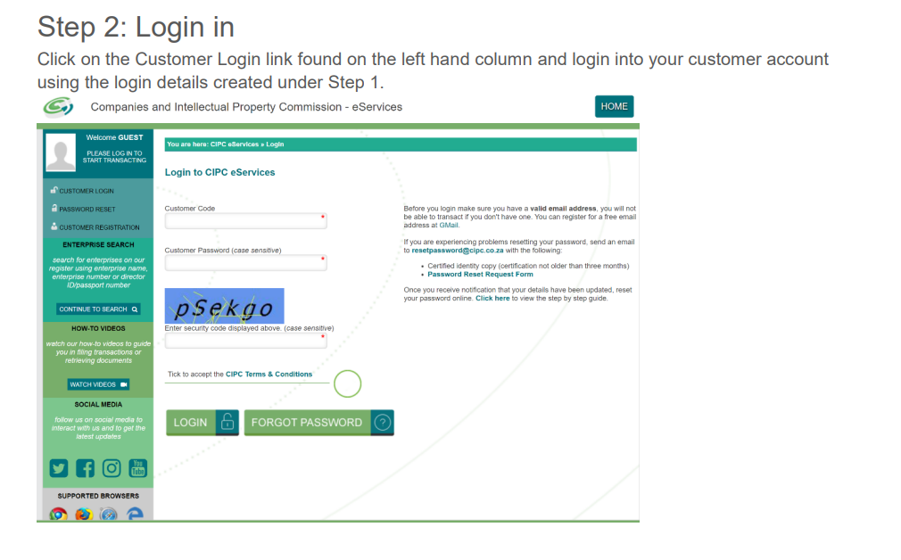

Slide 57
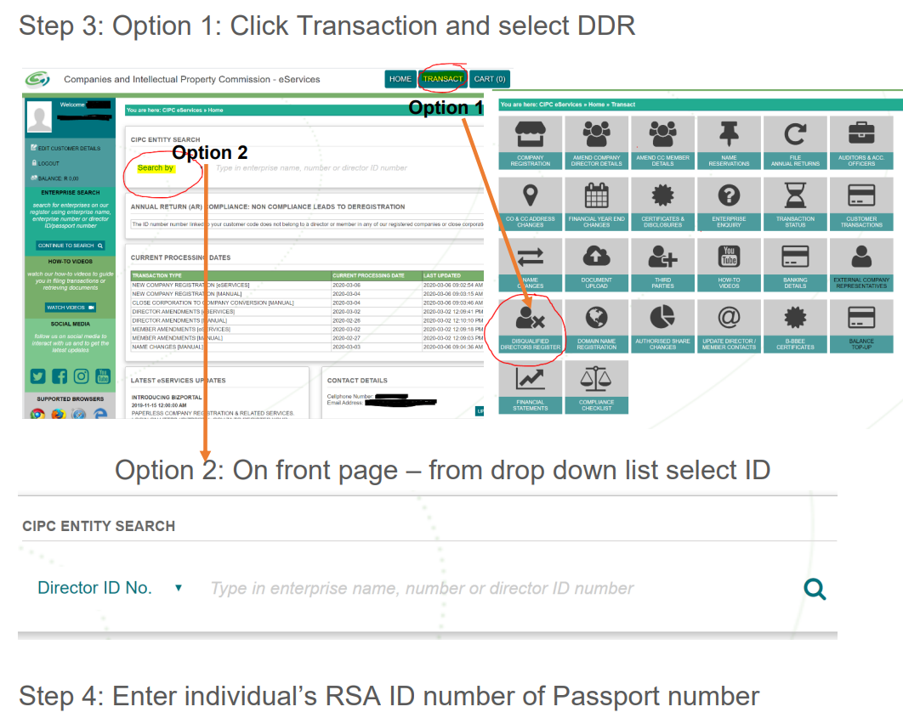

Slide 58
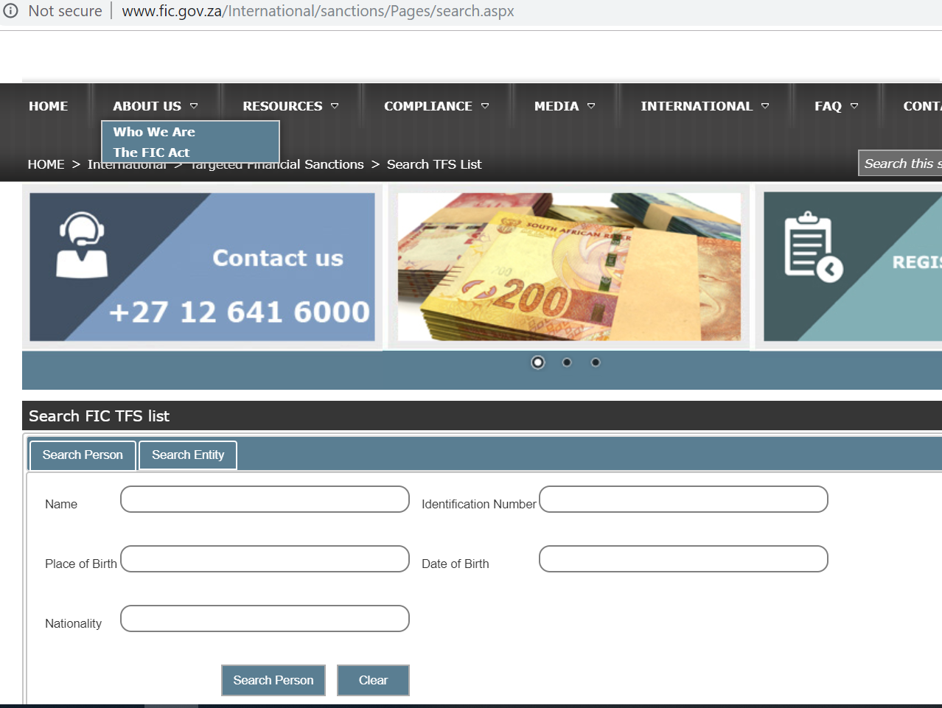
TARGETED FINANCIAL SANCTIONS – PROLIFERATION FINANCING
http://www.fic.gov.za/International/sanctions/Pages/thelist.aspx
FILLING OF VOLUNTARY DISCLOSURE – FIC
www.fic.gov.za

Slide 59
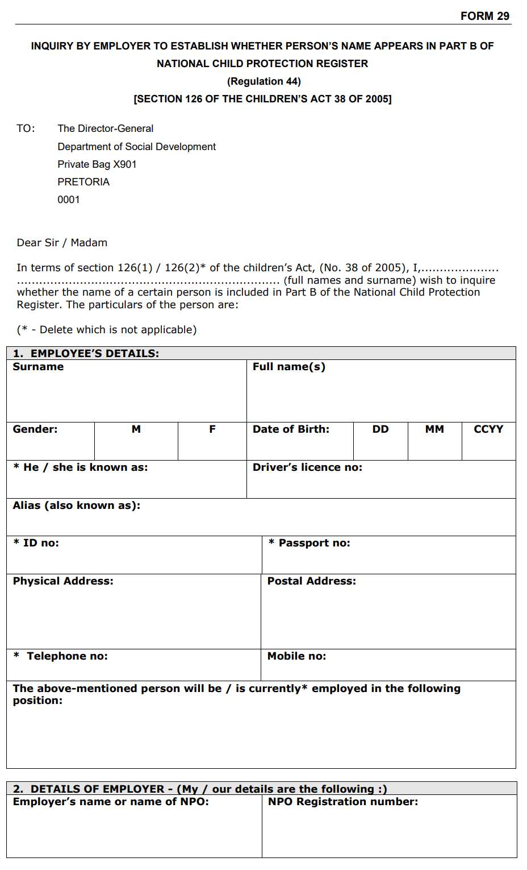
FORM 29
Form 29 – (DG Department of Social Development)
The Director General
Department of Social Development
Private Bag X901
Pretoria, 001

Slide 60
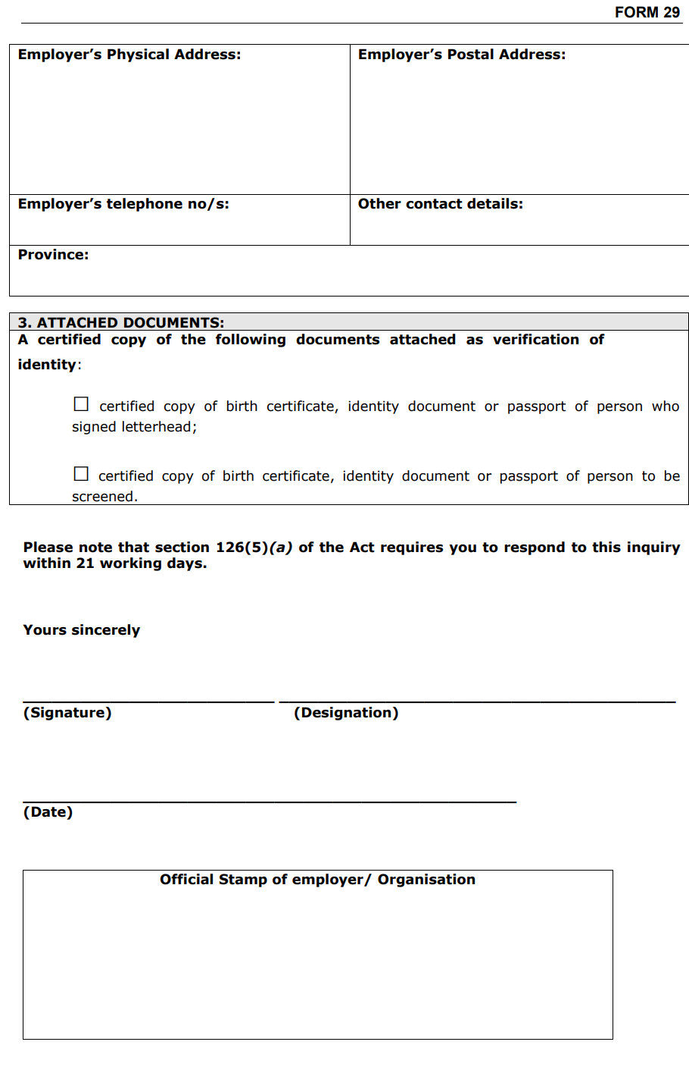

Slide 61
Conclusion
DSD is inviting NPO’s to partner with us in ensuring that:
The information on the amended NPO Act is cascaded down to your constituencies.
Ensuring that NPOs who’s registration is compulsory are encouraged to register within the stipulated time frame in the published gazette.
Assist the NPO Directorate in raising awareness on the potential vulnerabilities of the sector to Terror Financing and encourage your constituencies to apply proper control measures.
Assist the NPO Directorate in ensuring that NPOs comply with the new provisions of the NPO Act as amended.

Slide 62
The End
THANK YOU!!

