Slide 1
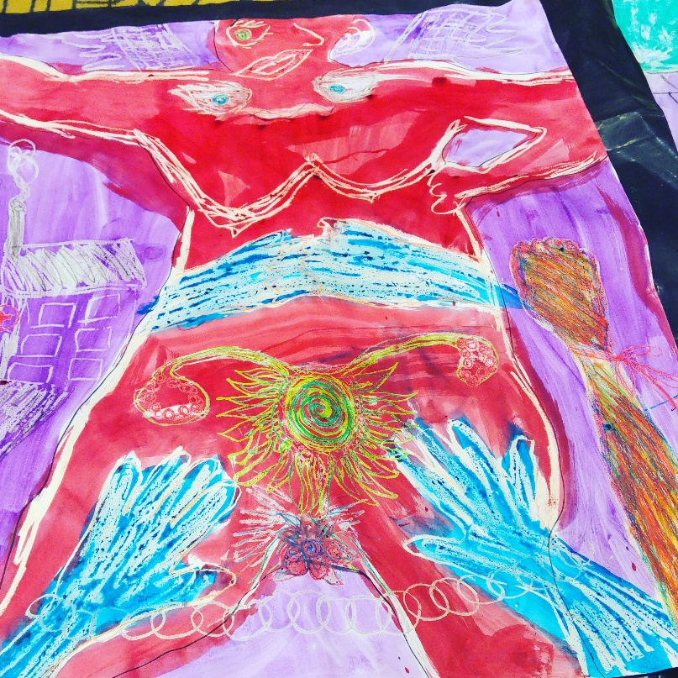
Marion Stevens
Political Sciences, Stellenbosch University
Outgoing and Founding Director, SRJC

Slide 2
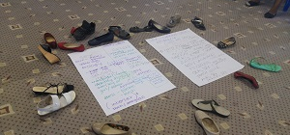
The Promise of Sexual and Reproductive Health: reflections of 25 years of democracy in a context of neocolonialism - Legacy of Population Control - Moments of Transformation and movement building - Legal and Policy reform - Financing and Governance - Contraception - Abortion

Slide 3
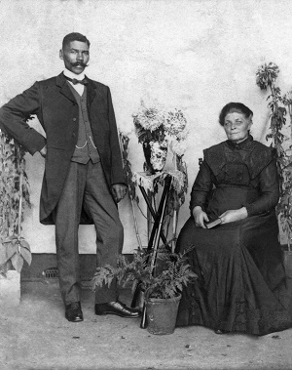
- Slavery, colonization, refugees
- Immorality Act
- Land & business – expropriation
- Race - apartheid
- Gender - (policing of sexuality, work and families)
- Population control
population vaccine, engineering

Slide 4
Women were cadres within the movement engaged in conflict and liberation struggles, and reproductive autonomy was not central to the political project.
‘ Women’s status has only recently started to receive attention in research and policy circles. The ANC would be taking an innovative step if it supported systematic measures aimed at removing the obstacles that have hindered women's development in South Africa. Such measures would have implications for population policy, since the status of women is related to their reproductive behavior’
Chimera Dan (1993)

Slide 5
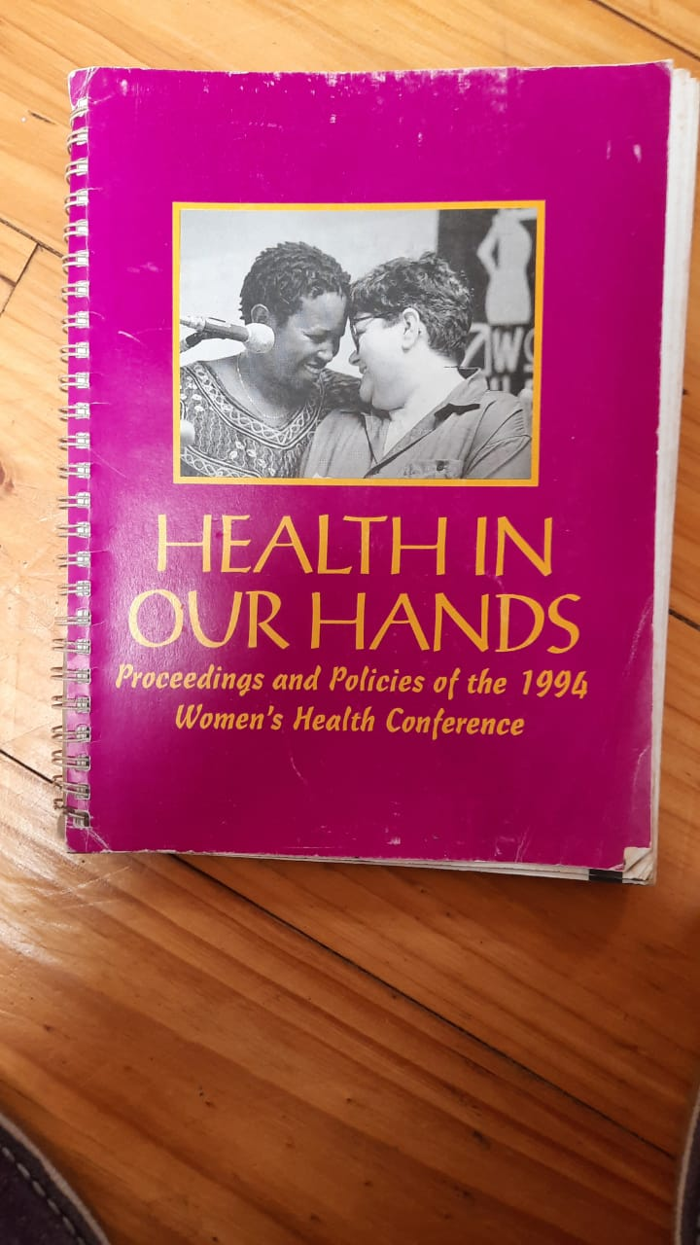
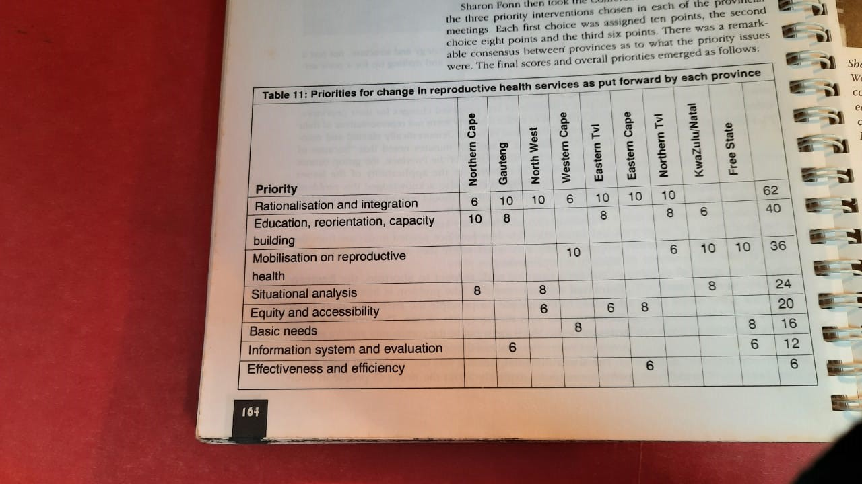
Women’s organizing
1994 Women’s Health Policy
Conference
13 different policies
4500 women
Seeded groups addressing abortion, violence
Strategic Management Teams in Provinces

Slide 6
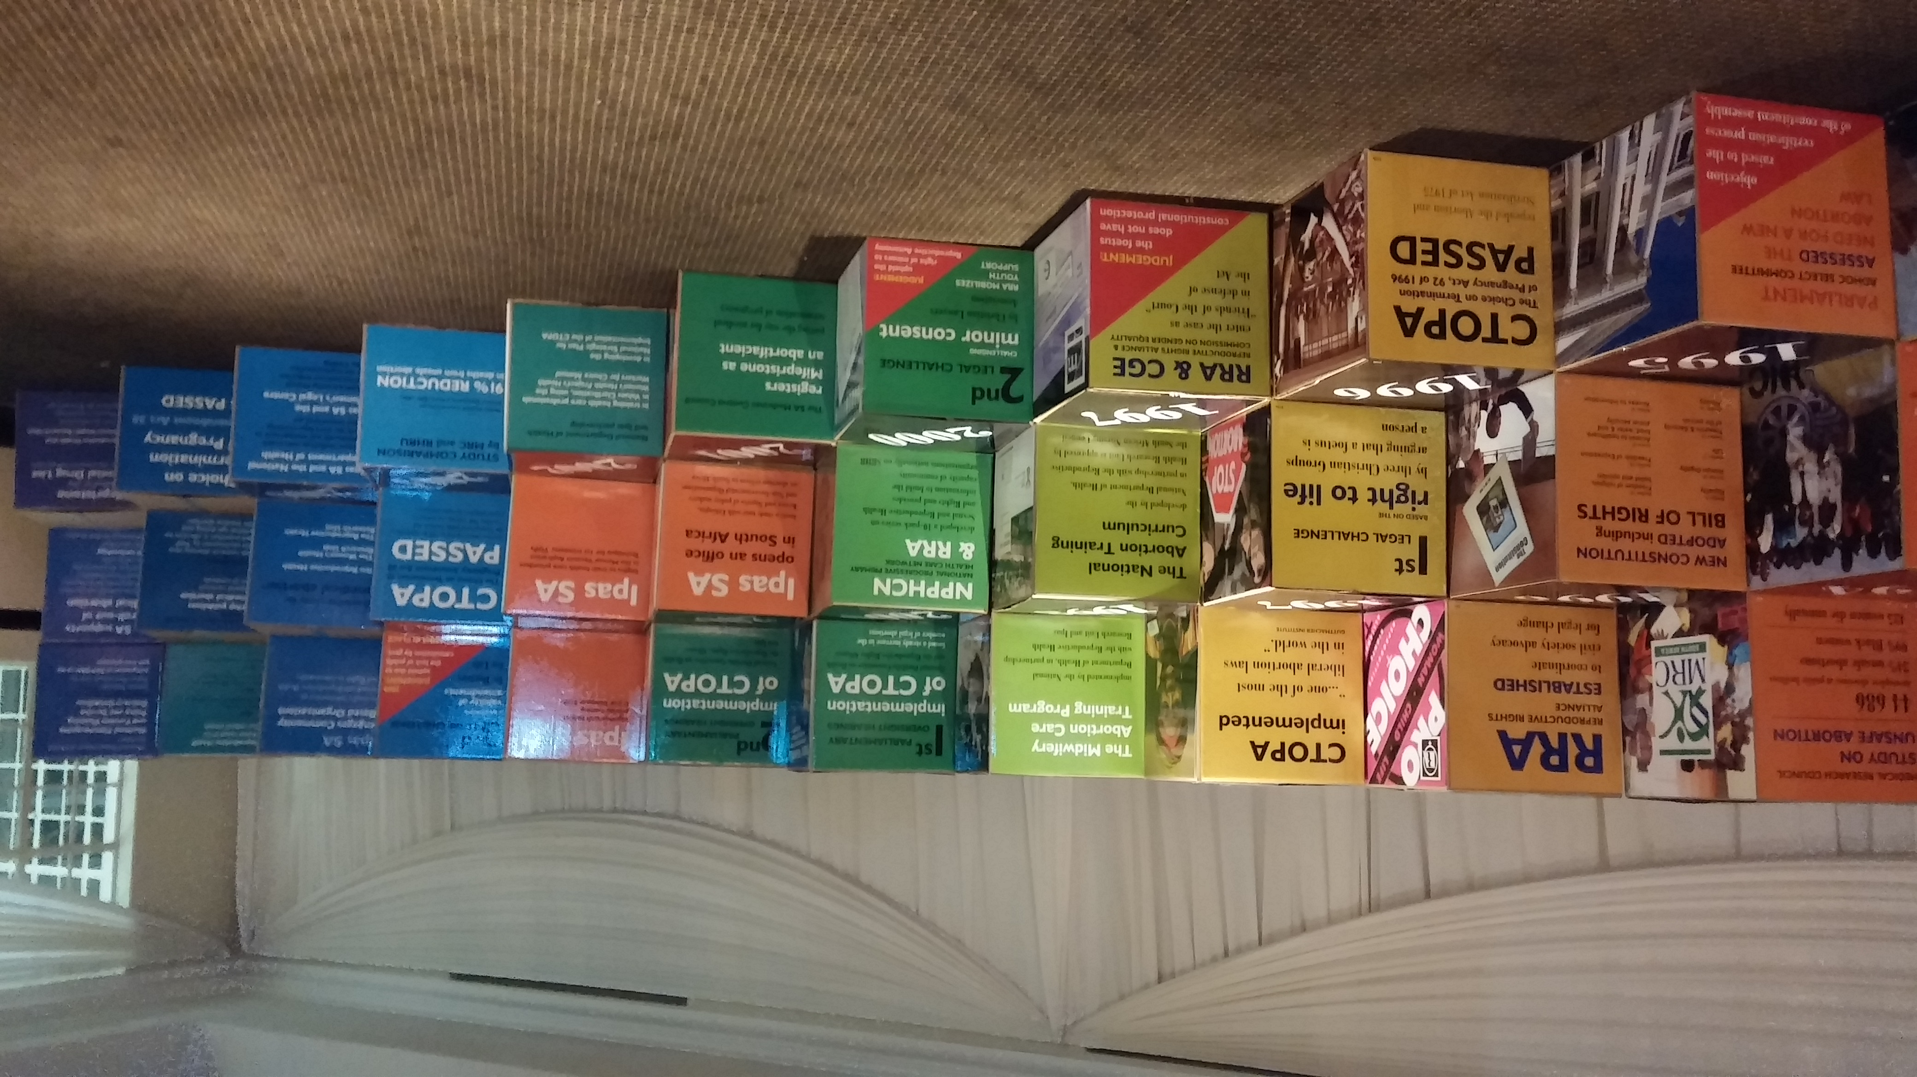
Population policy
SA Constitution, CTOPA
Global Commitments (ICPD, FWCW, Addis, Maputo)
Radical, social determinants of health
Overlapping and multiple oppressions, no single issues

Slide 7
HIV/AIDS pandemic Vertical programming Controlling fertility (PMTCT) – maternal lens Restrictive funding (US) Decimated and disorganized fragile women’s movement. Patriarchal leaders - consciousness and power complexity HIV separate from SRHR

Slide 8
Poor governance, capacity and financing - Gaps – HIV - Overbearing influence of donors - Self gagging, poor stewardship - Creep of US INGOs purview of state sector. US culture/neocolonial practice - Undermines local sustainability and movement building - Emergence of right-wing counter reproductive rights - Corruption

Slide 9
Contraception
Prevalence of 65% DMPA Many policy updates Method mix & Counselling
Coercion Couple year protection rate-
2014 Implant (1 million inserted) side effects
DMPA and HIV acquisition
Prevention as opposed to options

Slide 10
DMPA
2015/2016 5 578 228
2016/2017 5 814 786
2017/2018 6 027 784
2018/2019 6 206 245
(Massyn, Pillay & Padarath 2019; Massyn et al. 2020)
Guidelines
Post ECHO trial – HIV acquisition (contested community advisory body)
addresses adolescents, yet removes migrants and sex workers

Slide 11
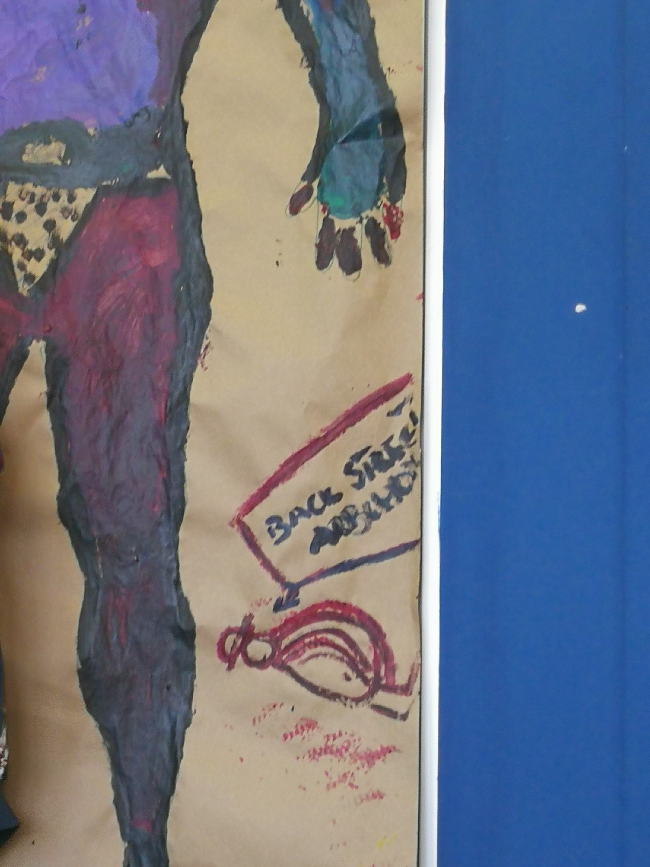
Abortion 1994 44,686 hospitalizations, 425 deaths 7% facilities provide services Over 50% outside formal services Septic abortion – top five – maternal mortality US 60 pregnancy crisis centres some in public facilities

Slide 12
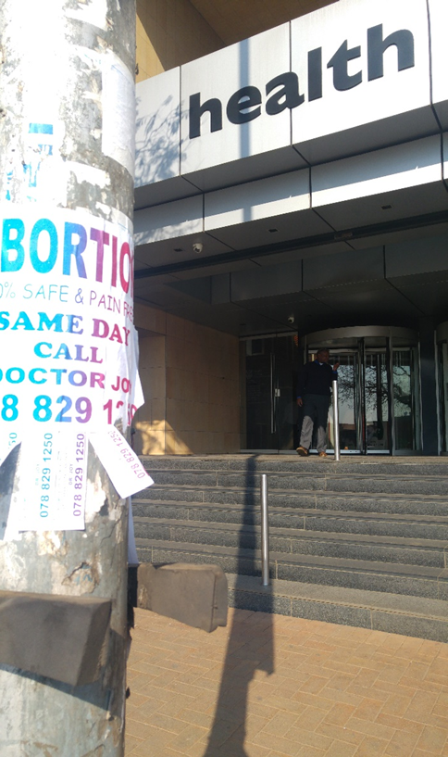
2019 Guidelines –
Counselling guide Obstruction to access – patient centered
Domain of US INGOs
Little agility or local adaption
Telemedicine/SMA
De-medicalisation

Slide 13
Concluding thoughts: - Over population, links to climate change – population control - Adolescent fear of sexual and reproductive health - Sexual and Reproductive Justice illusive – social determinants (individual and collective) of health compounding and interlocking barriers = contraception and abortion (Prevention) - Emerging right wing – US INGOs – - Neocolonialization – US Financing – INGOs and cultural practices, limits possibility of indigenous growth

